Slide 1
Optimizing medical PTS therapy
Suman Wasan MD, MS

Slide 2
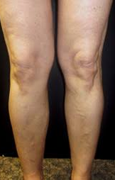
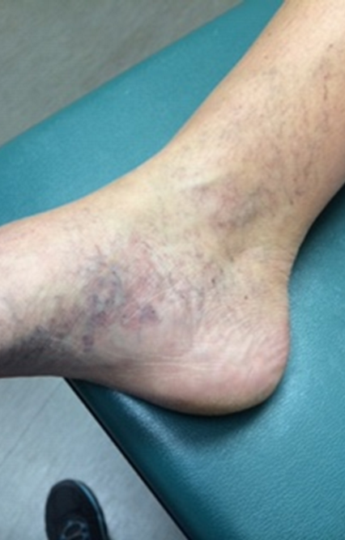
Case 1
45 year old WF
Right iliac/CFV DVT during last pregnancy
Taking low dose rivaroxaban for secondary VTE prevention
Foot and ankle swelling at end of day with heaviness in leg
Has developed varicose veins of medial gaiter area

Slide 3
What are the initial options for management of her PTS?
Compression
-strength and length
-wraps
-daytime and nighttime
Exercise
Venoactive drugs

Slide 4
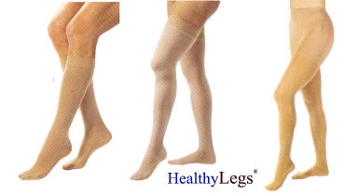
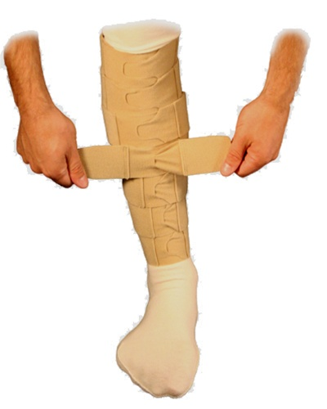
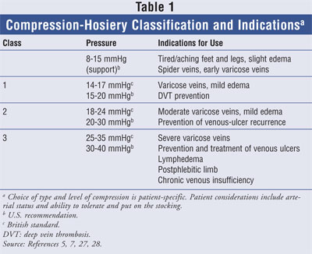
Compression
Notes:
JVS 2010: Contralateral limb of 73 patients undergoing VV treated evaluated and followed for 5 months.
CVI progression lower in patients with controlled orthostatism, controlled obesity and who wore compression hose.

Slide 5
Prolonged standing
Occupations with prolonged standing confer ↑ risk
High prevalence (38%) of CVI in hospital employees
Orthostatism (>4 hrs) associated with CVI progression
↑ risk of varicose veins in men and women; ↑ risk of nocturnal leg cramps in men
Leg elevation for 30 min reduces CVI and associated inflammation
Ziegler. Winer Klinische Wochenschrift (abst)2003;115:575
Kostas. J Vasc Surg 2010;51:900
Bank. Ergonomics 2012;55:133
Notes:
209 medical employees including doctors, nurses, technicians, secretaries, cleaners etc.
Prevalence of CVD in 70 employees (38%)
Standing at work was a predisposing factor. Highest prevalence in utility workers and cleaners and lowest in med techs, and secretaries.

Slide 6
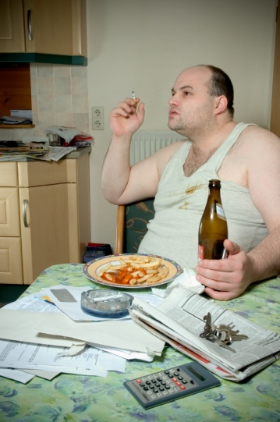
Obesity
CVI clinically more severe in obese associated with ↑ venous pressure in feet
↑ risk of varicose veins in obese: OR 3.28
Lap band treated obese patients had reduction in CVI
Van Rij. Eur J Vasc Endovasc Surg 2008;35:739
Clark. Phlebology 2010;25:236
Melissas. Southern Med J 1998;91:1143
Notes:
Eur J of Vasc Endovasc Surg 2008 Venous function and air phlethysmography and duplex scanning 934 consecutive patients presenting for assessment of venous disease.
Stratified by BMI. CEAP class assessed. CEAP clinical stage more advanced in obese patients. Venous foot pressure increased.
62 patients with morbid obesity: 13 had varicose veins with 11 showing improvement post lab band (12-48 mo f/u0

Slide 7
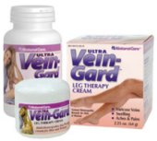
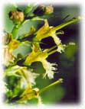
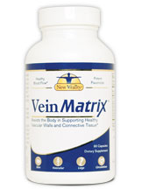

Herbal therapy for CVI
Horse chestnut seed extract
-aescin inhibits enzymes that induce leukocyte activation
-may ↓ capillary and venous permeability thereby ↓ edema
Micronized purified flavanoid fraction
-↑ venous tone and ↓ WBC activation
French maritime pine bark extract
-antioxidant and antiinflammatory effect
Notes:
Horse chestnut seed extract: active component is aescin: effective in reducing edema, ankle, calf circumference and leg pain associated with CVI by short term randomized studies (2-16 weeks).
Can cause hypoglycemia and prolong bleeding
MPFF: randomized trials up to 2 months duration showing inconsistent improvement in edema, cramps and ulcer healing
French maritime pine bark extract: phenolic acids
Randomized trials for 2 months duration shows reduction in edema and leg heaviness. AEs: inhibitory effect on platelets with increased bleeding
Rutosides: plant flavonoid antioxidants that decrease microcapillary permeability and edema.

Slide 8
Exercise
Exercise that involves repetitive dependent thrusting such as running should be avoided
Swimming preferred for patients with edema
Structured exercises to strengthen calf muscles can improve calf muscle pump function and reduce CEAP class
Folkes. Int J Epidemiol 2001;30:846
Padberg. J Vasc Surg 2004;39:79
Zajkowski. Phlebology 2006;21;100

Slide 9
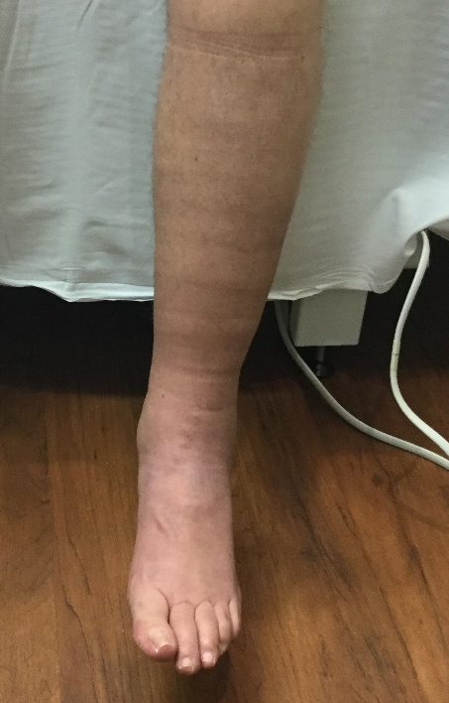
Case 2
65 year old WM
Left external iliac vein DVT post MVA/motorcycle accident
Swelling and heaviness, worse in evening
Leg cramps at night
Wears 20-30mmHg compression socks daily
Walks 1-2 miles 3X per week
C3

Slide 10
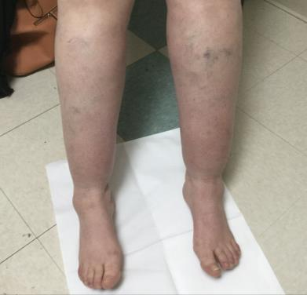
C3 – Where there is swelling, there are overtaxed lymphatics
CEAP Stage
  C3 – Edema (pitting)
  C3 – Edema (non-pitting)
Lymphatic stage & involvement
  Lymphedema Stage 1: Soft swelling; possibly intermittent, likely daily; resolves with elevation or overnight
  Lymphatics are unable to accommodate the excess venous filtrate and swelling occurs
  Lymphedema Stage 2: Spongy swelling due to fibrosis; does not resolve with elevation; possible hyperkeratosis and scaly skin
  Extended excess venous filtrate overtaxes lymphatics, resulting in protein buildup and permanent damage and/or obstruction of lymphatics
=
=

Slide 11
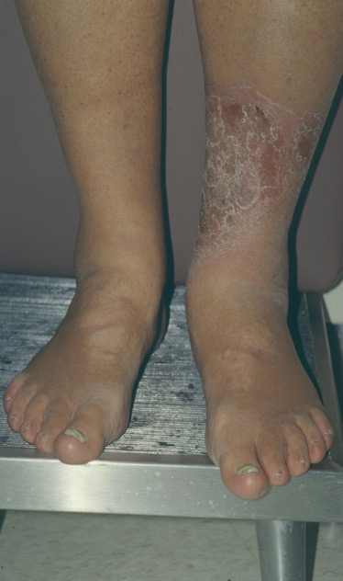

Swelling (C3)
Chronic stasis dermatitis (C4a)
This patient has secondary lymphedema
or phlebolymphedema!
S. Dean

Slide 12
CVI contributes to edema via altered lymphatic function
CVI is the leading cause of lymphedema in the U.S.¹
Venous Insufficiency
Lymphatic Overload
Permanent Damage²
1. Farrow W. Phlebolymphedema–A Common Underdiagnosed and Undertreated Problem in the Wound Care Clinic. The Journal of the American College of Certified Wound Specialists. 2010;2(1):14-23.
2. Scelsi R, elt al. Morphological changes of dermal blood and lymphatic vessels in chronic venous insufficiency of the leg. Int Angiol. 1994 Dec;13(4):308–11
Notes:
CVI is the leading cause of lymphedema in the western world, because resulting venous hypertension can cause excess filtration to the interstitial space, which unchecked can overload and ultimately causes permanent damage to the lymphatic system

Slide 13
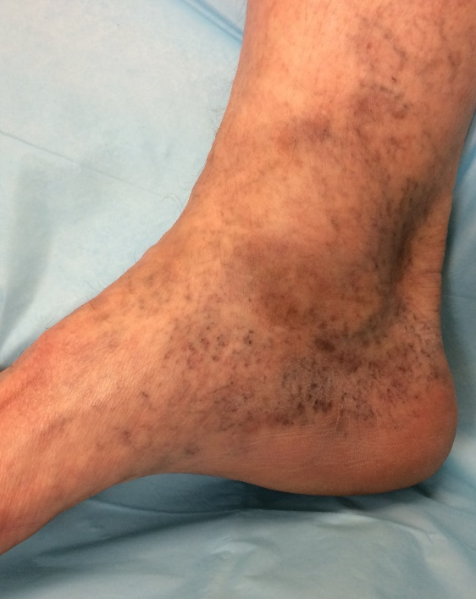
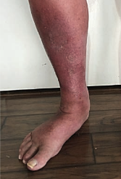
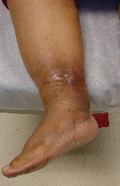
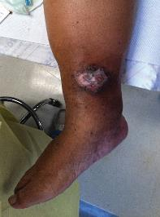
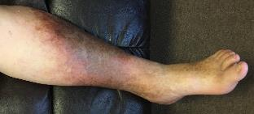
Concurrent Venous and Lymphatic Disease Progression
C2
C3
C4a
C4b
C5
C6
Venous Insufficiency
Venous Hypertension
Edema
Stagnant Proteins
Susceptible to Infection
Hyperpigmentation
Eczema / Contact Dermatitis
Fibrosis
Wounds
Fat Deposition
Progressive and Irreversible Lymphatic Damage^{1,2,3}
1. Farrow W. Phlebolymphedema–A common underdiagnosed and undertreated problem in the wound care clinic. The Journal of the American College of Certified Wound Specialists. 2010;2(1):14-23
2. Scelsi R, et al. Morphological changes of dermal blood and lymphatic vessels in chronic venous insufficiency of the leg. Int Angiol. 1994 Dec;13(4):308–11
3. Ruocco E, et al. Phlebolymphedema: disregarded cause of immunocompromised district. Clin Dermatol. 2012 Sep-Oct;30(5):541–3. doi: 10.1016/j.clindermatol.2012.04.004.
Notes:
There is an important cascade of events here beyond the venous disease progression you’re used to seeing via skin changes. skin changes are indicative that there’s more going on in the dermal lymphatics.
Namely:
-Venous insufficiency results in venous hypertension, which increases fluid filtration into the interstitial space
-As the filtration overloads lymphatic capacity, edema results, with protein rich fluid accumulating within the interstitial space creating a local environment susceptible to inflammation and infection
-As the lymphatics are overloaded and damaged, the local immune response in that edematous limb becomes compromised
-This can lead to recurrent infections and sluggish immune response, or hypersensitivity for some resulting in contact dermatitis
-fibrosis forms in response to chronic inflammation, further inhibiting lymphatic function and local immune response
-chronic wounds resulting from end stage CVI can be further complicated by recurrent infections that both result from and further contribute to this two system dysfunction

Slide 14
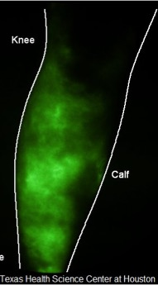
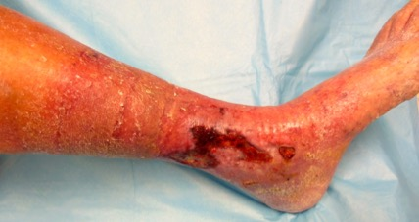

Lymphatic transport in patients with CVI & Venous Leg Ulcerations
12 patients with active unilateral VLU underwent indocyanine green lymphography (ICGL) of the BLE
All 12 ulcerated limbs = abnormal ICG lymphography
Rasmussen et al. J Vasc Surg: Vein & Lymph Dis 2016;4:9-17

Slide 15
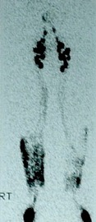
Venous-lymphatic disease:
Lymphoscintigraphic abnormalities in CVI
Hammond 1991- 36 /48 (75%) of extremities with CVI had an abnormal lymphoscintigram
Weissleder 1998- 27/34 (79%) of patients with CVI had an abnormal lymphoscintigram
Hammond et al. J Bergan (Ed), Venous disorders., 1, WB Saunders, Philadelphia (1991), pp. 333–343
Weissleder H, Radiology 1988; 167:729-735

Slide 16
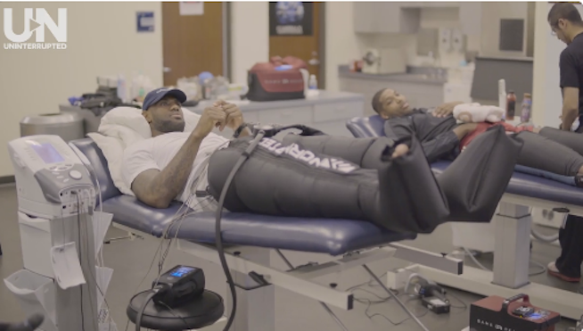
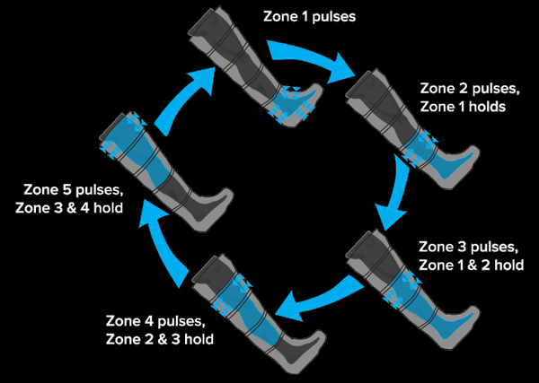
Compression pumps
Sequential gradient pump
Bio Compression Systems
Lympha Press USA
CircuFlow Lymphedema Compression
Sports recovery
Normatec Recovery pump
Flexitouch

Slide 17
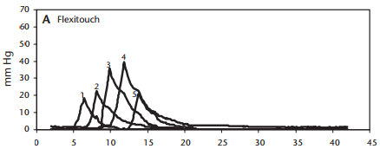
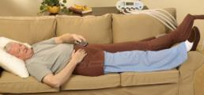
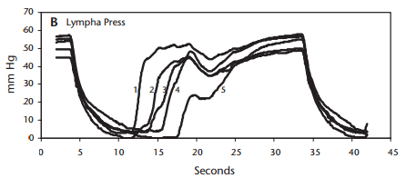
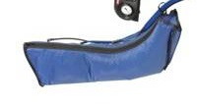
Flexitouch system vs. other PCDs
Not all PCDs are the same: The physiologic mechanisms applied are distinct
Flexitouch System
“Work and Release”
Truncal stimulation + extremity stimulation
Mild, dynamic pressure delivered in 1-3 second intervals
Gentle “work and release” action
Traditional PCD
“Press and Hold”
Extremity stimulation only
High pressure delivered over longer periods of time
“Press and hold” action
16. Mayorvitz H.N. et al. (2007) Interface Pressures Produced by Two Different Types of Lymphedema Treatment Devices. Physical Therapy. 007;Vol.87(10)1379-1388.
Notes:
Flexitouch works to simulate the effect of manual therapeutic massage. The garment chambers gently inflate to stimulate the fragile lymph capillaries. Brief sequential pulses promote the movement of lymph through the lymphagions increasing the frequency and velocity of lymph transport.
This “work and release” action is what therapists try to achieve during MLD to help promote function of the lymph system.
The “work and release” action of the Flexitouch has been demonstrated in a clinical study measuring the applied pressure with 5 different sensors applied to a patient’s arm.
Compare this to the “press and hold” action of other pneumatic compression device that uses much higher pressure over a longer sustained period of time – different from MLD technique used by physical therapists.
Flexitouch also has more smaller volume chambers that deliver localized treatment and decongests the trunk while treating affected extremities in lymphedema patients.
Not all PCDs are the same: The physiologic mechanisms applied are distinct

Slide 18
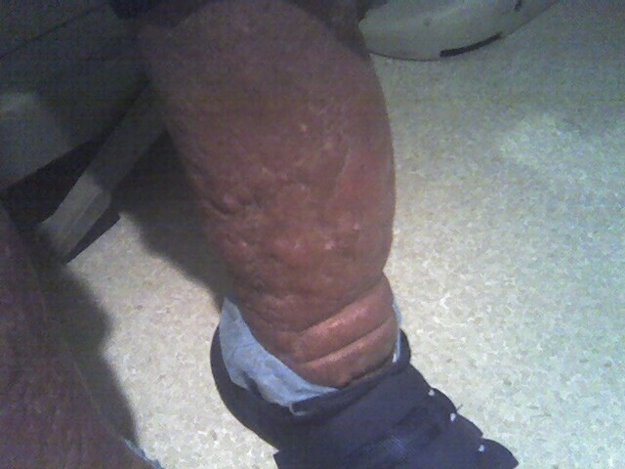
Phlebolymphedema
Venous stasis with secondary lymphedema

Slide 19
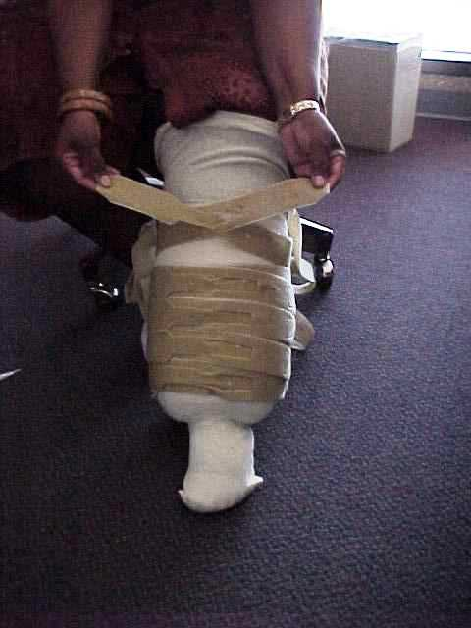
Compression therapy
(Circaid strap)

Slide 20
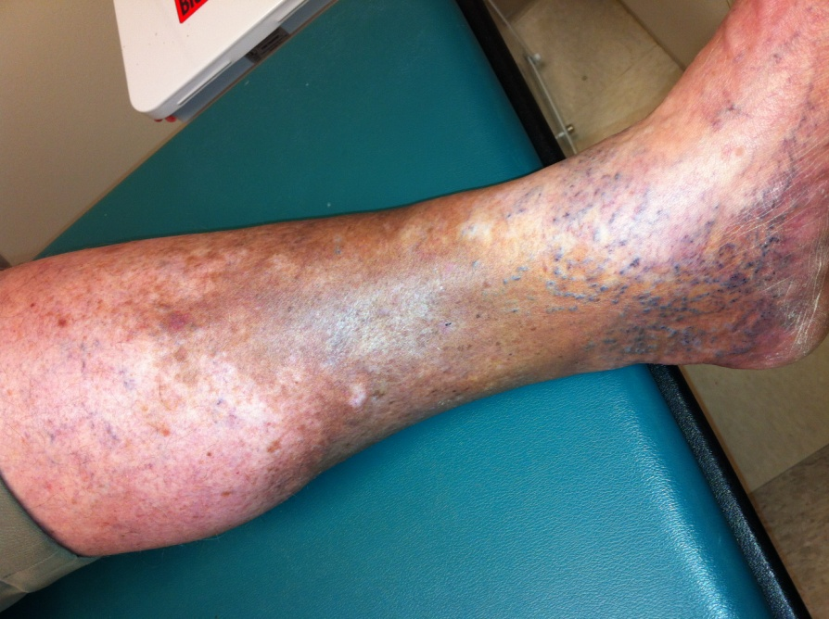
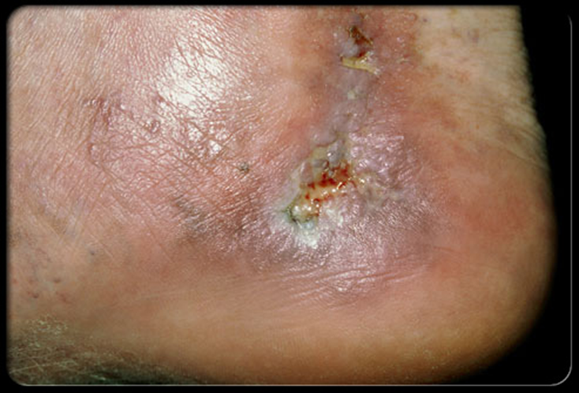
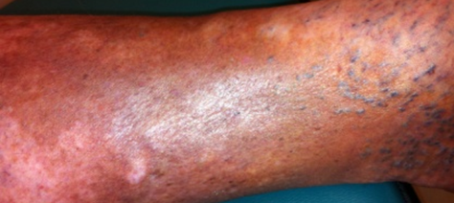
Case 3
72 year old BM
C4b skin changes
Intermittent oozing from ankle wound
Wears 30-40mmHg compression daily
Elevates legs at night
Walks to complete ADLs only

Slide 21
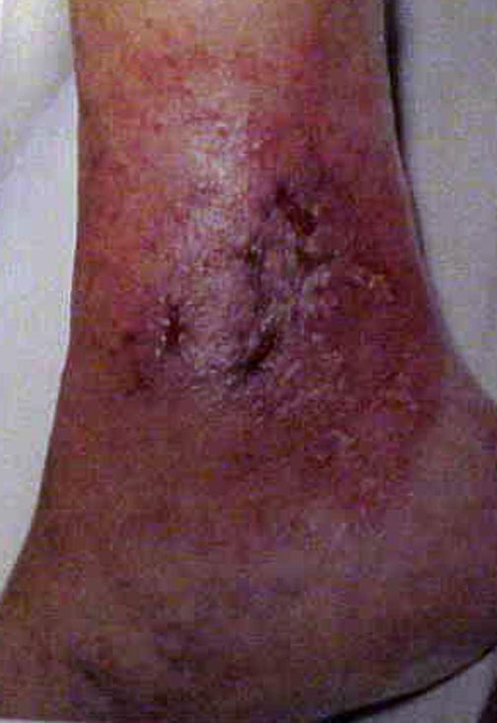
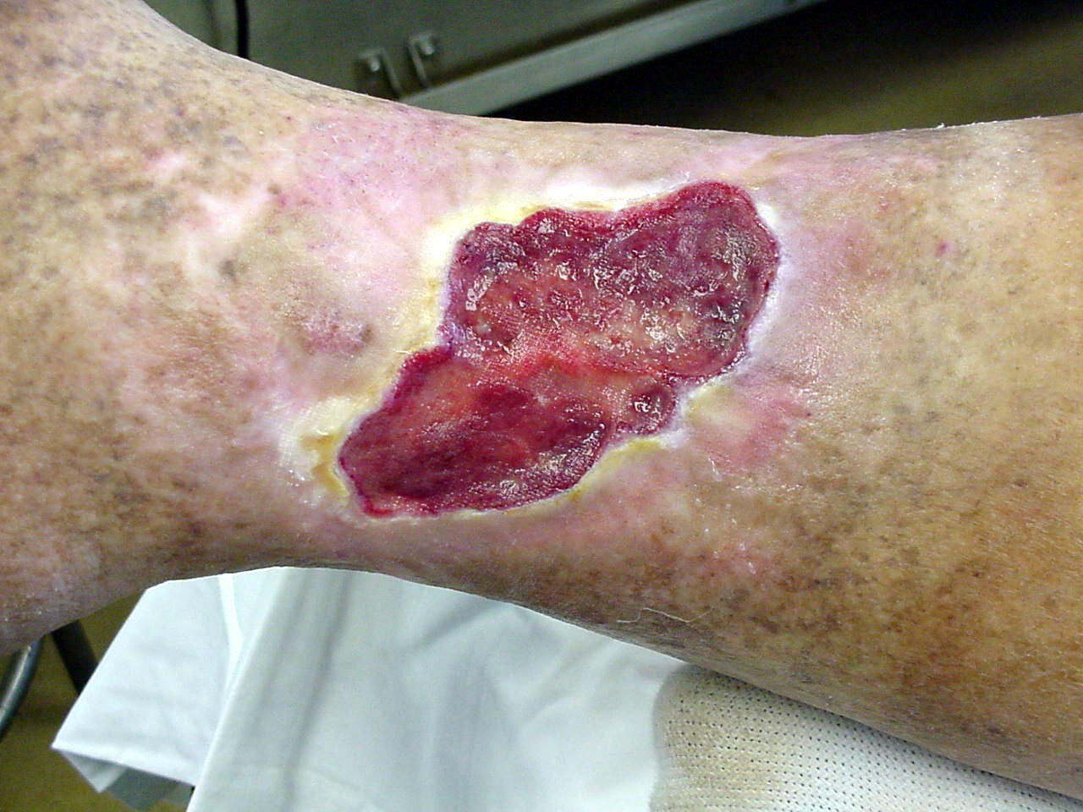
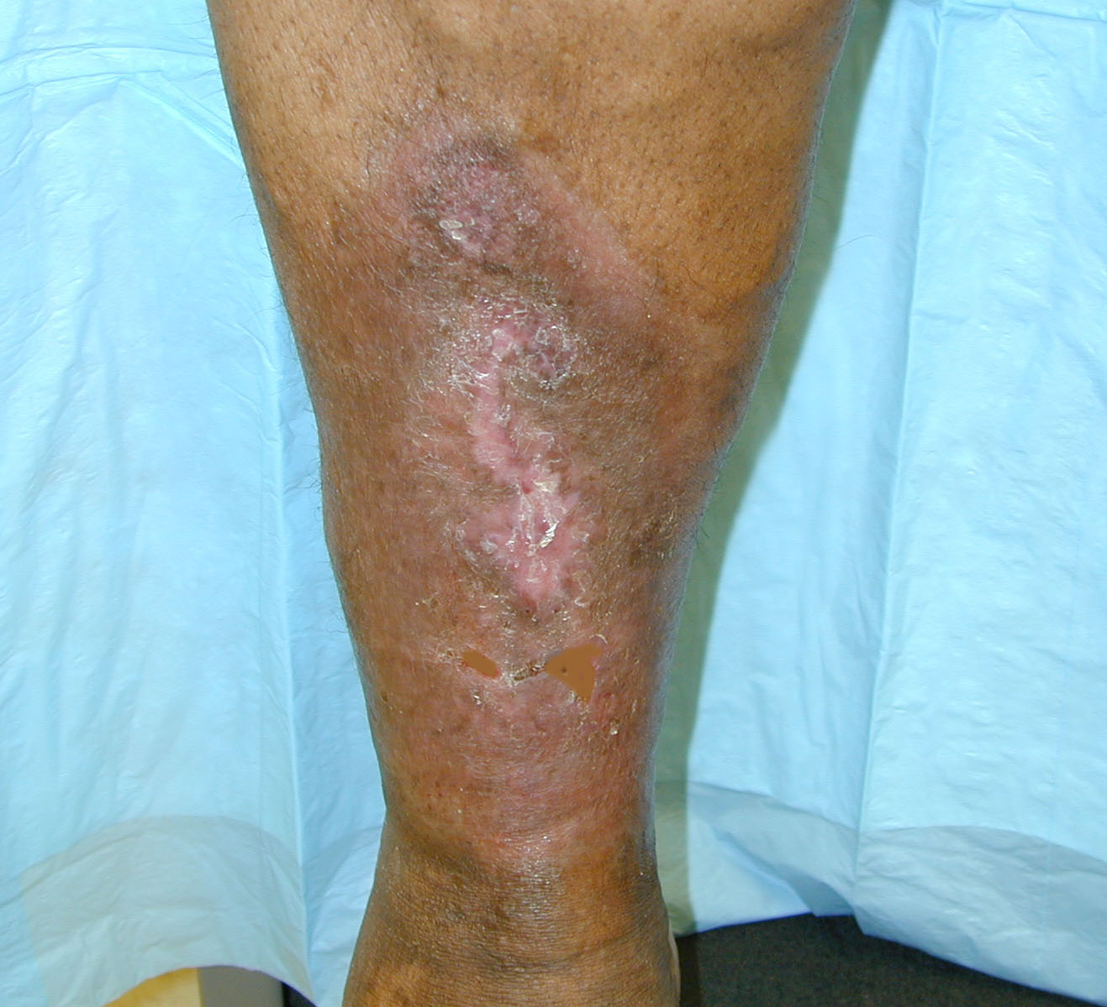
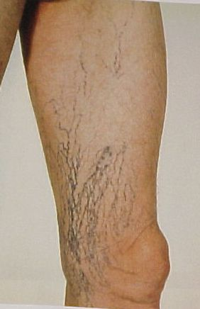
CEAP Classification
C0 No visible or palpable venous disease
C1 Telangiectasies or reticular veins
C2 Varicose veins
C3 Edema
C4 Skin and subcutaneous changes (a, b)
C5 Healed venous ulcer
C6 Active venous ulcer
E Etiology (Congenital, Primary, Secondary)
A Anatomic (Superficial, Deep)
P Pathophysiology (Reflux, Obstruction, Both)
American Venous Forum 2004

Slide 22

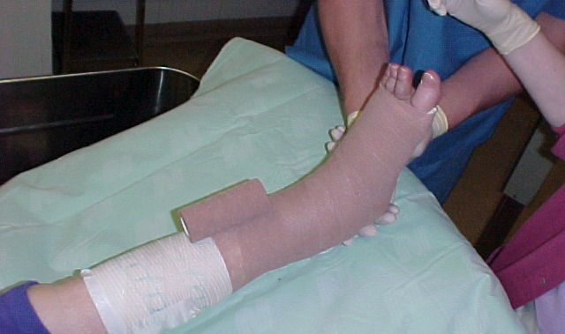
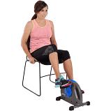
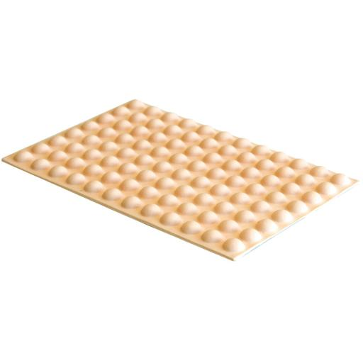

Slide 23
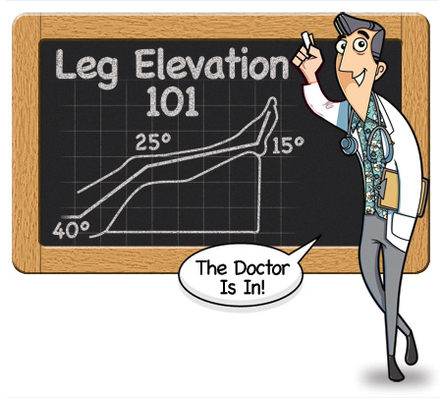
Treatment - Medical
Lifestyle
Reduction of edema
Elevation
Compression therapy (wraps, hose, pumping)
Drug therapy (diuretics, antibiotics, herbals)
Skin care (protective dressing, exfoliation)
Ulcer therapy
Notes:
Lifestyle: avoid prolonged standing and sitting
Elevate feet above thighs when sitting: 30min tid reduced dermal edema
Repetitive thrusting exercise ex running may increased venous pressure; Swimming ideal
Low dose diuretic may help for short course
Stasis dermatitis may respond to short term of intermediate to high potency topical steroid

Slide 24
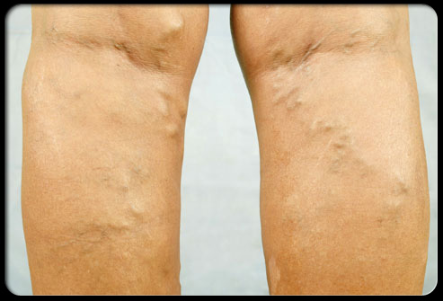
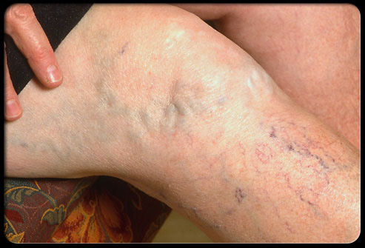


Slide 25
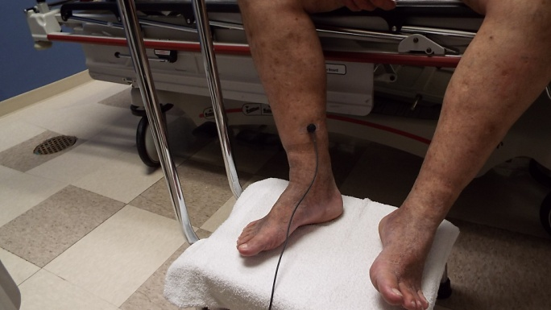
Photoplethysmography (PPG)
Used to study blood flow and blood volume changes in the skin
Probe with light source and light sensitive diode positioned on skin; proximal to medial malleolus
Backscatter of light detected by light-sensitive diode affected by number of RBCs in dermis
RBCs absorb maximum light in seated/standing position (CVI evaluation)

