Slide 1
The C-TRACT Trial
Chronic Venous Thrombosis: Relief with Adjunctive Catheter Directed Therapy
Generating Potential Patient Interest and Translating to Enrollment
(Group Discussion Q&A)
Angela Oliver, RN BSN MS
C-TRACT Trial Manager

Slide 2
“Harsh Reality”
Total Trial Enrollment: 374
NIH Year 3 Milestone
Goal (by 8/31/2020): 112
Current Enrollment: 52
We need a commitment from every site to demonstrate improved enrollment by May 2020.
Notes:
Enrollment is lagging - potential for study discontinuation is a reality.
- The study’s DSMB and the NHLBI will formally review the trial in May. Now that we have been “open to enrollment” for 2 years, they will seriously assess whether or not to continue funding the study.
- Keep in mind, this is a huge, taxpayer-subsidized, trial with the purpose of advancing care of patients with PTS. If we as a network cannot perform (enroll), it NIH’s responsibility to question whether the study should remain open. - If closed, this would be tremendous loss for endovascular research.
Average enrollment per month is 2-3 patients.
Our original expectation was for sites to enroll 0.5 patients per month. If you have not achieved that minimum benchmark (i.e. 3 patients over the last 6 months), then you should be looking hard for additional ways to attract patients.

Slide 3
You are important piece of the Enrollment Puzzle
Notes:
We need everyone’s assistance.
Unlike those with acute DVT, the population of patients with moderate-to-severe PTS is largely an outpatient population.

Slide 4
“E” - Engage Co-investigators and Collaborators
Reach out to your key referral sources, vascular lab, wound care clinics, and hematology – identify where PTS patients may be in your system.
Relying on their usual referral pathways (e.g. clinic) as your only source of recruitment will significantly limit your recruitment pool.
Notes:
Don’t forget nurse coordinators, physician assistants, clinic schedulers, ultrasound lab personnel.

Slide 5
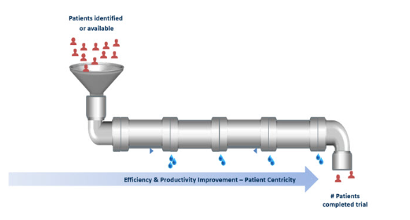
“E” - Engage Co-investigators and Collaborators
“Leaky Funnel” analogy – ACRP training/Covance
Notes:
The “leaky funnel” or “leaky pipe” analogy is commonly used by CROs to exploring problem areas with recruitment. When we focus all our recruiting efforts in clinic, we are starting at the last “joint” or “fitting” in the pipe – we’ve missed all of the potential patients who have not made it to our specialty provider clinic.
Funnel = community. We know there are 350,000 to 600,000 people who develop DVT each year.
25 – 50% of DVT patients go on to develop PTS.
How do we raise awareness in the community? Social media posts? Local education program? (weigh out effort versus yield)
First “joint” - Primary Care/Internal Medicine.
Second “joint” – Hematology (assisting with maintenance issues); medical supply vendors
Third “joint” – Wound Care providers, US labs (specialty providers that are helping to evaluate or manage a complication”

Slide 6
Coordinators can serve as a very important “positive force” in encouraging site PIs to contact local colleagues.
Notes:
It does take quite a bit of effort to figure out who the key “gatekeepers” are to access PTS patients. Likely – you will be doing that work (turning on the process for the “water to even run through the pipe”.)

Slide 7
“N” – New Strategies May be Needed
Re-assess your current strategy.
Several strategies should be “in play” at any given moment.
If you find you are consistently marking “No screenings this month” on your monthly Pre-Screening/Screening Log, an adjustment in
your recruitment approach is needed!

Slide 8
“R” – Respond
Respond to patient inquiries quickly!
Once you have identified a potential patient, make necessary accommodates in clinic to evaluate the patient as quickly as possible.
Notes:
Try to respond to patient inquiries within 24 hours (including referrals from CCC)
CCC has an approved general screening tool that can be shared.
Even if patient is not eligible (5 minutes into the conversion you learn he/she has a stent), determine can you “help” this patient? (Many of the patients who call the CCC are not eligible – but often “desperate” to learn of potential new resources.) If the patient is located from an area geographically distant to your clinic – give me a call!
Evaluate if you are the “right person” for the recruitment calls. Do you feel comfortable/confident discussing the study? Is there a coordinator with more clinical training that may be more appropriate for follow up/pre-screening calls? Do you engage your co=investigator(s) or PI with difficult calls or patients with complex histories?

Slide 9
“O” – Ownership is Key!
“Hands-On” PI, a dedicated coordinator, and engaged supporting study team are a true recipe for enrollment success!
Each investigator must take a vigorously pro-active, systematic approach to identify
nearly every PTS patient diagnosed in his/her institution, and to reach out beyond the hospital setting to FIND
PTS patients wherever they are.

Slide 10
“L” - Leverage Institutional Resources
What resources are available at your institution to help with outreach?
Is there a CTSA affiliated with your organization?
Center Clinical Research Services
Marketing Department
Media outreach
Recruitment Registries
Electronic Medical Records
Notes:
Clinical and Translational Science Award (CTSA) initiative - a large-scale NIH program whose goal is to support major NIH clinical and translational research.

Slide 11
“L” – Leadership is Critical
Identifying a site “champion” or “cheerleader” who will ensure the C-TRACT remains a top priority is critical to recruitment success!
Notes:
Who fills this role at your site?

