Slide 1
The C-TRACT Trial
Chronic Venous Thrombosis: Relief with Adjunctive Catheter Directed Therapy
Coordinator Session:
Screening Efforts, Managing Study Data & Outcome Events
Discussion Leaders:
Angela Oliver, RN BSN MS, C-TRACT Trial Manager
Marc Filion, MSc, CCRP, DCC Project Manager

Slide 2
SCREENING EFFORTS

Slide 3
Pre-Screening/Screening
The Pre-Screening/Screening Log serves as a tracking document to capture site efforts to identify potential patients with a clinical history of chronic DVT and current symptoms of PTS, but who are not randomized due to factors such as:
  Unable to confirm presence of iliac vein obstruction on imaging
  Presence of one or more exclusion criteria prior to consent
  Patient refusal to participate in research

Slide 4
Pre-Screening/Screening
Important Reminders:
Patients who meet all inclusion criteria, have no exclusion criteria, give consent, and are randomized are not reported on the Pre-Screening/Screening Log.
A scanned version of the completed Log should be submitted to the DCC at the end of every month (reporting activities of prior month).
Coordinate with your PI and Co-Investigators to ensure complete reporting of all site team recruitment efforts for the month.

Slide 5
Pre-Screening/Screening Log
Reporting Scenarios
Scenario 1:
Patient A consented to study participation on April 1st and was scheduled for the Baseline visit on April 8th. After receiving feedback from the insurance company regarding potential costs, patient ended participation prior to completing the Baseline visit.
Notes:
Scenario 1 Answer: Check off “ELIGIBLE but non-consenting”.
Reminder: The requirement for insurance pre-authorization remains an important part of the protocol and must be completed prior to randomization.

Slide 6
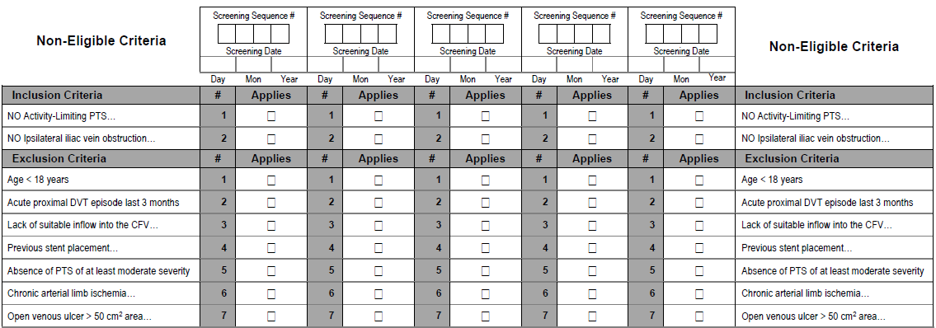
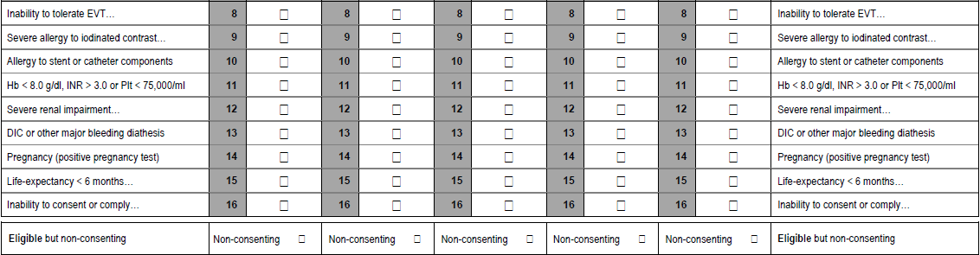
Notes:
Scenario 1 Answer: Check off “ELIGIBLE but non-consenting”.

Slide 7
Pre-Screening/Screening Log
Reporting Scenarios
Scenario 2:
Your EPIC Best Practice Alert (BPA) flagged a potential patient with history of DVT and current leg swelling. Upon review of the medical record, you discovered that the leg was stented last year.
Notes:
Scenario 2 Answer: Check off Exclusion criterion #4 “Previous stent placemen…”.
Reminder: Coordinators should be reporting all pre-screening efforts including EMR searches. Some teams are reporting use of EMR screening tools during coordinator calls, but we are still seeing “0” pre-screenings on the monthly logs.

Slide 8
Notes:
Scenario 2 Answer: Check off Exclusion criterion #4 “Previous stent placemen…”.

Slide 9
Pre-Screening/Screening Log
Reporting Scenarios
Scenario 3:
A potential patient presents with a history of DVT and PTS symptoms. Severity of symptoms were verified as moderate-to-severe during a recent clinic visit. CT venogram verified iliac vein obstruction. The patient refused to participate in the study because they wanted to pursue stent placement.
Notes:
Scenario 3 Answer: Check off “ELIGIBLE but non-consenting”.
Consideration: It is especially important to reports patients that are non-consenting due to refusals to be randomized either because they want insist on moving forward with stenting or they are afraid of the procedure. Again, we are seeing “0” patient pre-screening on the monthly log but hearing from site investigators that patients are refusing to be randomized.

Slide 10
Notes:
Scenario 3 Answer: Check off “ELIGIBLE but non-consenting”.

Slide 11
Pre-Screening/Screening Log
Reporting Scenarios
Scenario 4:
A potential patient presented to clinic with history of chronic DVT and current leg symptoms. CT venogram does not support a finding of iliac vein obstruction.
Notes:
Scenario 4 Answer: Check off “NO Ipsilateral iliac vein obstruction…” under Inclusion Criteria.
Emphasis – we CANNOT enroll based on US duplex results. Additional points RE Imaging:
The imaging should be an acceptable method as described in the protocol (CTV, MRV, venogram or IVUS)
It must be obtained within 12 months prior to date of consent.
A de-identified report with the iliac vein findings must be in the patient’s binder and uploaded to the ORCCID CCC Source Documents folder.
**General radiologist often complete the initial imaging and often call the results “normal”, especially if there is any flow. We recommend that your PI or designated Co-INV (IR/vascular surgeon) personally review the images for potential cases to determine presence of iliac vein obstruction. A handwritten attestation form by the PI noting review and obstruction/%stenosis may be needed.

Slide 12
Notes:
Scenario 4 Answer: Check off “NO Ipsilateral iliac vein obstruction…” under Inclusion Criteria.

Slide 13
Pre-Screening/Screening Log
Reporting Scenarios
Scenario 5:
An established patient with chronic DVT and moderate PTS including venous ulcer returned to clinic for a follow-up visit. The treating physician indicated any additional imaging to rule out iliac vein obstruction was not considered standard of care.
Notes:
Scenario 5 Answer: Check off “NO Ipsilateral iliac vein obstruction…” under Inclusion Criteria.
Suggestion – if a Co-investigator, consider escalating to your PI for internal team review. Consider escalating to the CCC to discuss this case and explore all issues to minimize risk of losing a potential patient.

Slide 14
Notes:
Scenario 5 Answer: Check off “NO Ipsilateral iliac vein obstruction…” under Inclusion Criteria.
Suggestion – if a Co-investigator, consider escalating to your PI for internal team review and possibly the CCC to explore all issues to minimize risk of losing a potential patient.

Slide 15
Consent
Confirm all Inclusion and Exclusion Criteria prior to consent
Consent date serves as the “anchor point”
Use Screening ID to track patient. Patient is not registered in ORCCID or IRIS at this time
After removal of the Run-In period with Protocol 4.6 (8/2/2019), consent can occur as the first task of the Baseline visit.
Notes:
Confirm all inclusion criteria prior to consent (Thoughts for emphasis/discussion: Based on current protocol criteria, verify all inclusion criteria (moderate-to-severe PTS, DVT > 3 months ago, imaging verification of iliac vein obstruction) prior to consent. US imaging is not sufficient to document iliac vein obstruction.
Use screening ID to track patient (Patient is not registered in ORCCID or IRIS at this time.)

Slide 16
Baseline/Pre-Randomization Visit
Schedule…
Clinician with appropriate experience and study-specific PTS training should conduct the PTS assessment at Baseline visit
Ensure US lab follows C-TRACT compression and reflux protocol (which may differ from standard of care protocols)
VCSS, Villalta, and Clinical Labs must be obtained within 1 week of randomization
Patient does not need to remain at the center for randomization. Create a plan for randomization and how you will communicate assignment to patient.
Enter and upload the data within 2 week of the completed visit.
Notes:
Clinical staff with study PTS training with appropriate clinical background/expertise can conduct PTS assessment at Baseline visit (blinded clinician not required)
Make sure Non-blinded attestation form has been signed if not Blinded Clinician at Baseline visit
Ensure non-blinded assessor is listed on your DOA Log with “clinical assessment” privileges
Randomize the patient as quickly as possible to minimize risk of creating a scenario in which the patient may have to repeat a procedure.
Process the data as quickly as possible post visit.
If patient is randomized to EVT arm, schedule a call with the CCC to review the data collection requirements for the procedure.

Slide 17
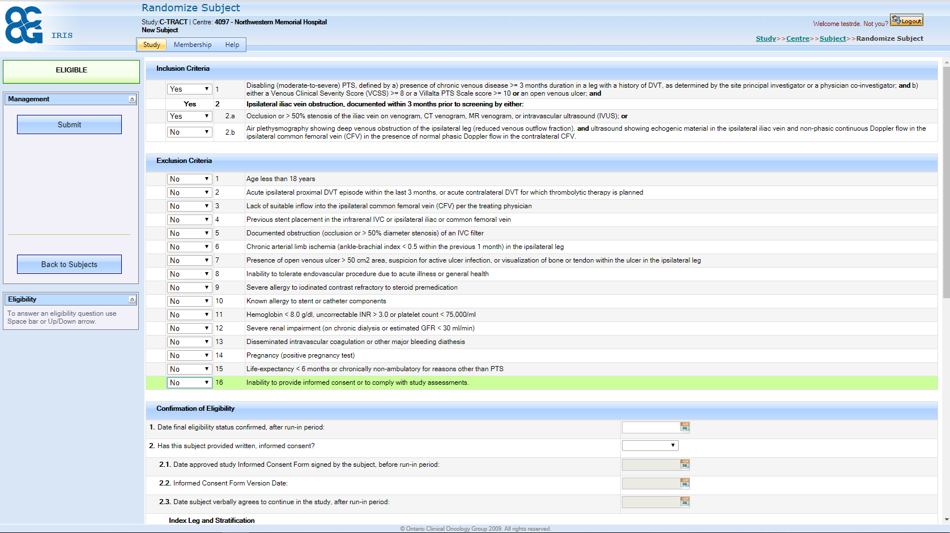
Randomization
Notes:
Patients are randomized on-line in IRIS.
Need consent information, stratification details and lab results.
Subject ID number and treatment arm assigned after randomization.
Baseline and all subsequent Follow-up data entered in ORCCID.

Slide 18
Follow-Up Visits - Reminders
Schedule the follow up visits within the protocol window. Communicate with the CCC if you are having difficulties scheduling a follow-up visit.
Blinded Clinicians should conduct PTS and Index leg assessments at all post-randomization follow-up visits.
If the PI or Co-Investigator does not directly participate in the follow-up visit, schedule a time to review the patient’s status, PTS care, and any concerns/questions. Create a note!
Send patient stipend after every completed follow-up visit
Retaining the patient is important!
Notes:
We are starting to see protocol visit deviations. The windows are large enough visit window deviations should be minimal unless due to a confounding medical issue. Ensure you have a back-up coordinator who is trained and ready to help with the visit when you are unavailable.
CCC should know about planned deviations in advance whenever possible.
Blinded clinicians must conduct PTS assessments at follow up visits. If clinic NPs or MDs are blinded clinicians, they should not follow the patients clinically outside the study.
Even if the PI does not conduct an official assessment at the visit, face-to-face interaction with the PI or Co-I is an effective retention tool.
There must be documentation of PTS care and assessment of that care at each follow up visit. Our monitor will ask for a research Note to File or copies of de-identified clinic notes demonstrating on-going PTS care.
The $100 patient stipend per follow up visit is not negotiable.

Slide 19
STUDY DATA

Slide 20
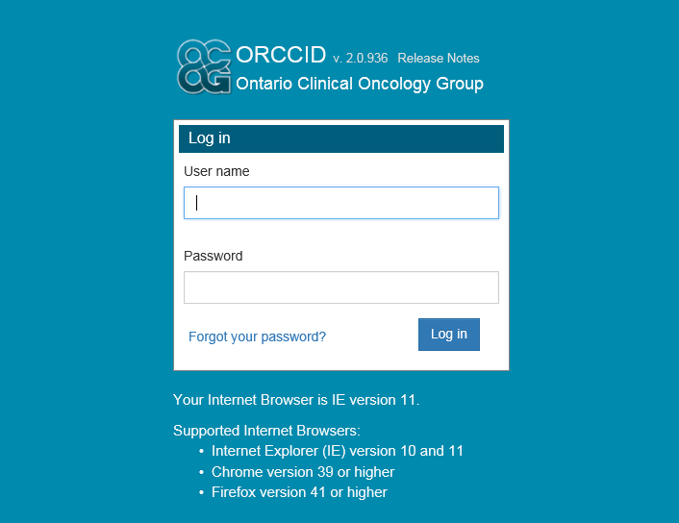
Study Data
Study data is entered via DCC’s web-based remote data capture system:
ORCCID: Online Remote Collection of Clinical Information and Data
ORCCID training and system is accessed online by selecting the direct link on the C-TRACT study website: (www.bloodclotstudy.wustl.edu) – Researcher Portal
Data queries generated and managed in ORCCID
After data review/verification by the DCC – QI sign-off required in ORCCID

Slide 21
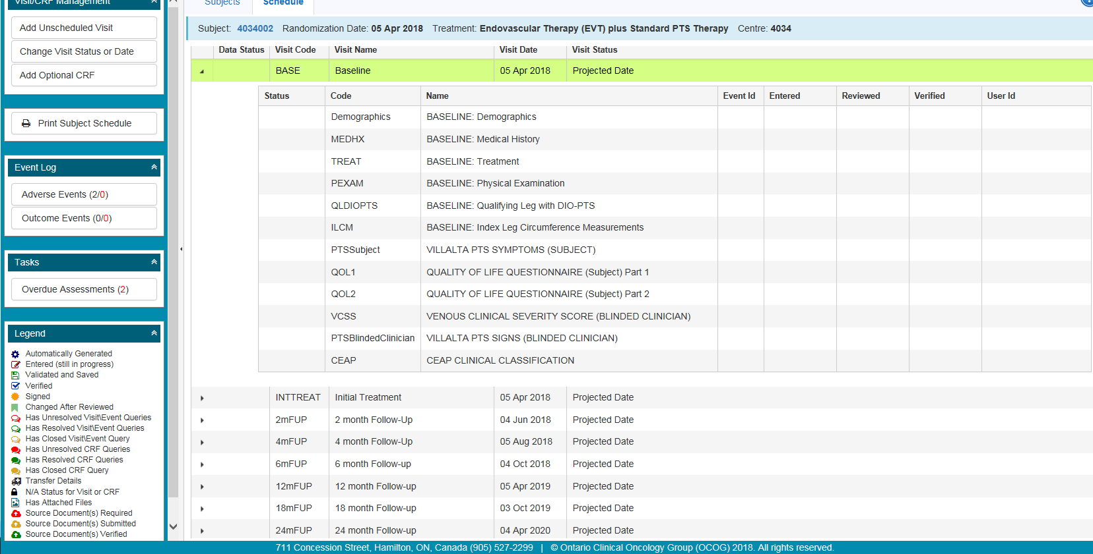
Study Data
Database modules are pre-populated for each study visit
Required source documents are specified at each study visit
Site teams should enter data and upload source within 2 weeks of the subject visit

Slide 22
Source Documents
Source documents are specified at each study visit or event and are uploaded directly into ORCCID – NO paper source sent to the DCC
Must be labeled with at least the following information:
  Study Acronym (C-TRACT)
  Subject ID Number (e.g., 4034-001)
  Study Visit (e.g., Baseline, 6-month Follow-up ,etc.)
  ****Please use the source document labels provided by the CCC.
All identifying information such as subject name, MRN, etc. must be blinded (de-identified) prior to uploading source to ORCCID
Please review every page of the source documents prior to ORCCID upload to ensure all identifying information has been blinded and that each page is labeled.

Slide 23
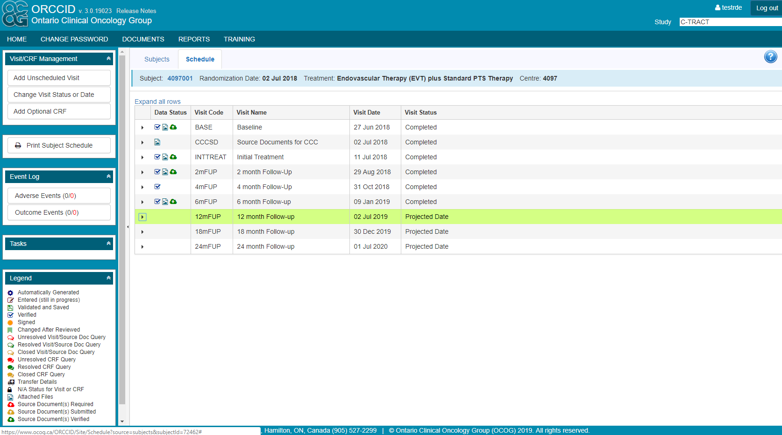
ORCCID

Slide 24
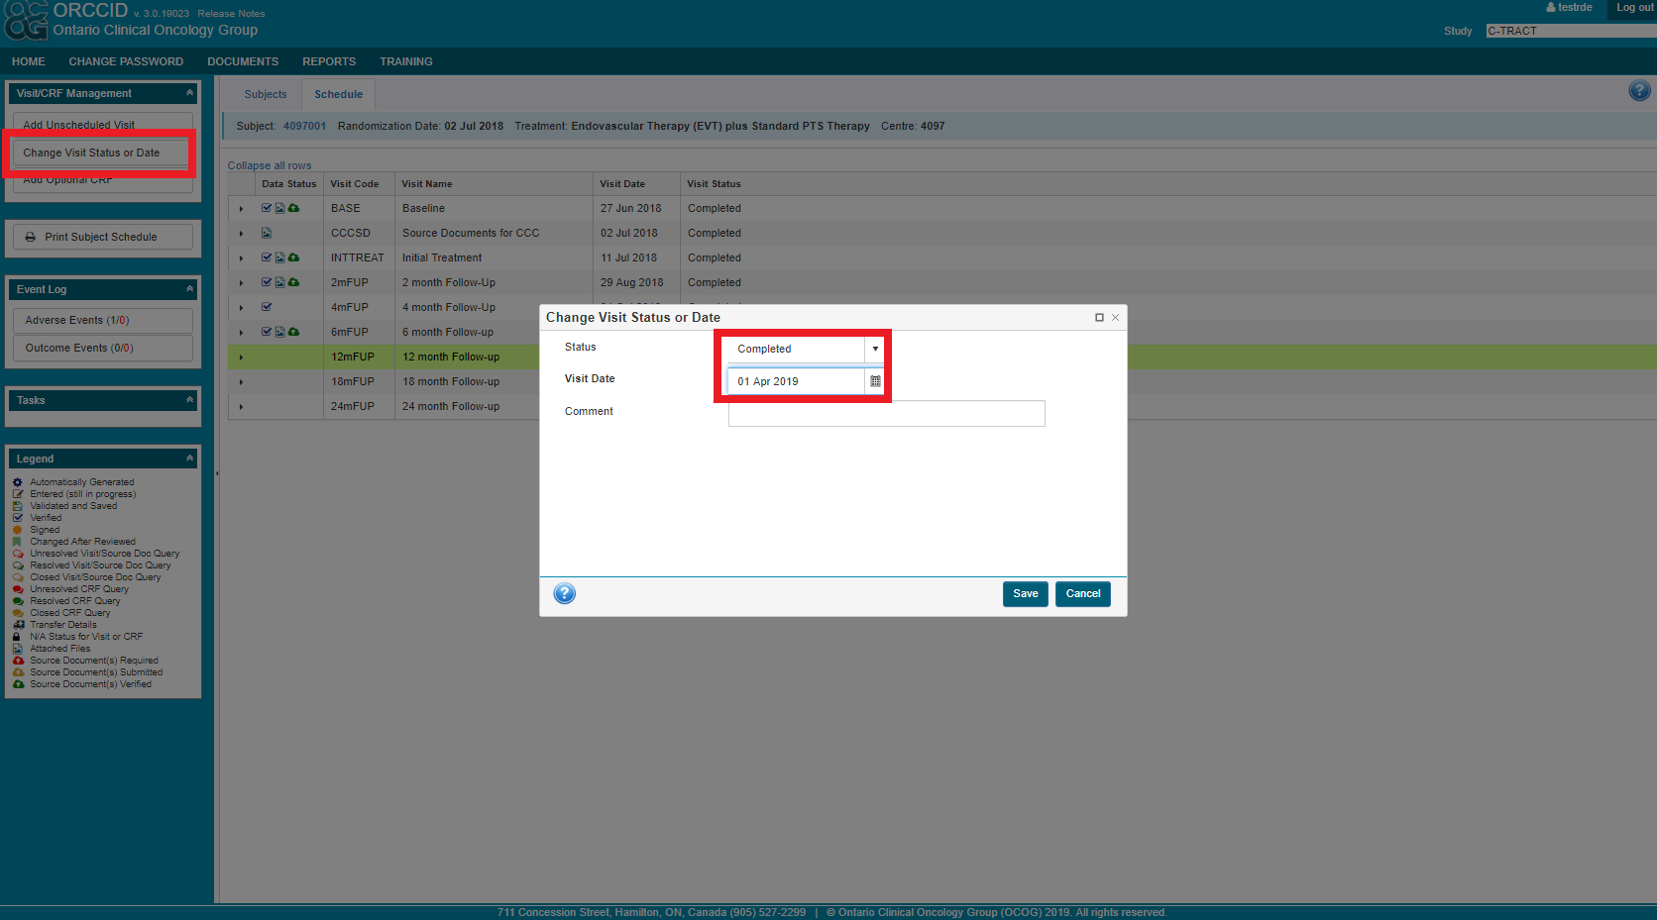
ORCCID

Slide 25
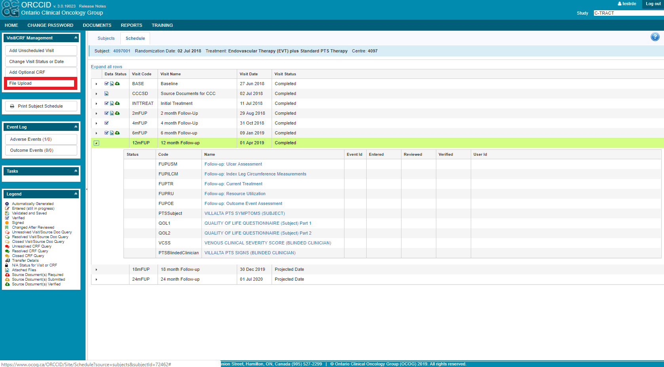
ORCCID

Slide 26
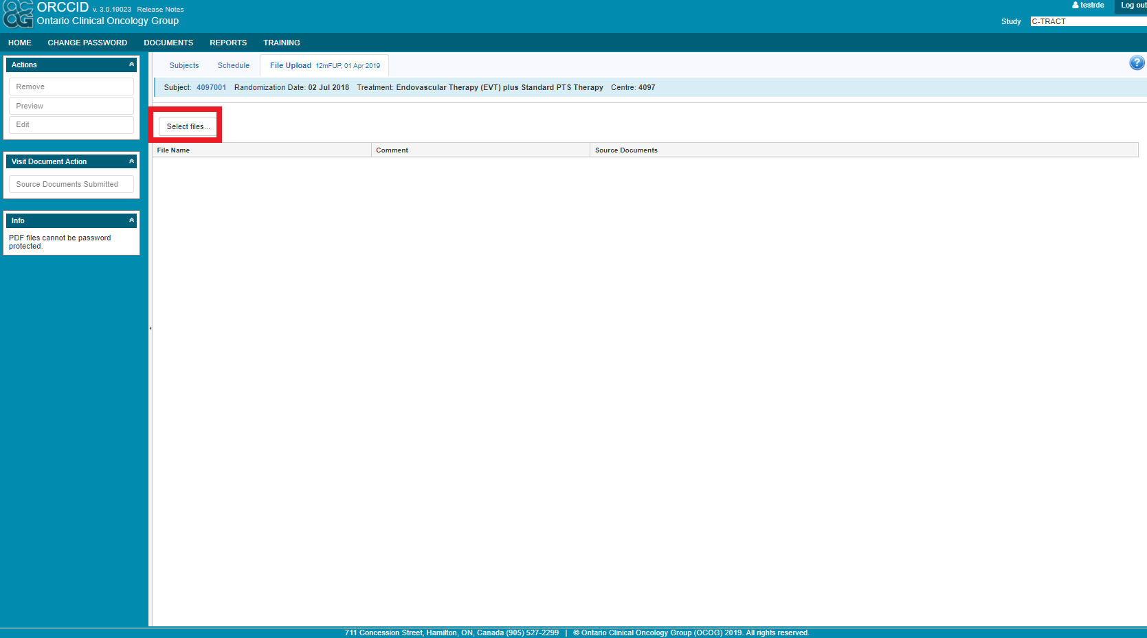
ORCCID

Slide 27
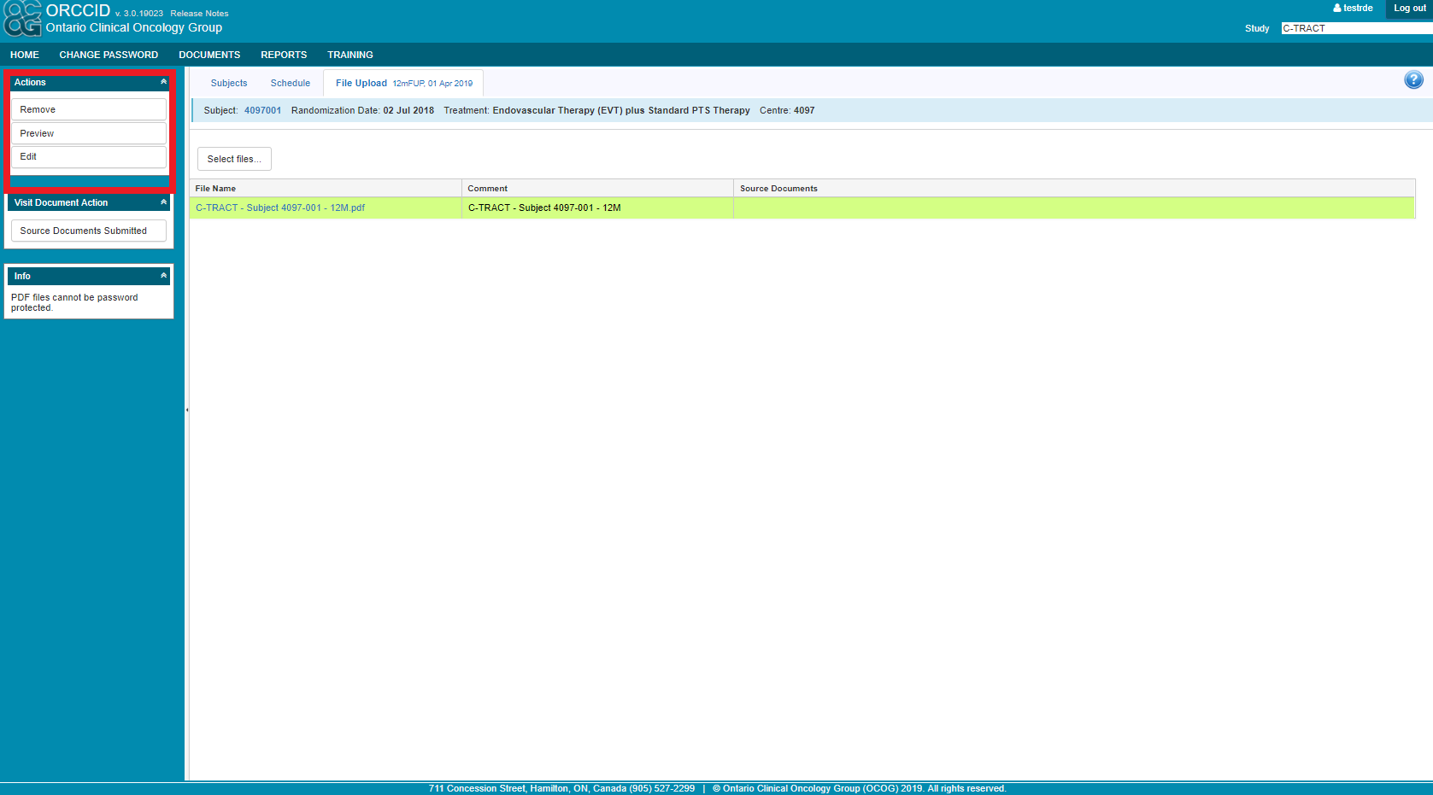
ORCCID

Slide 28
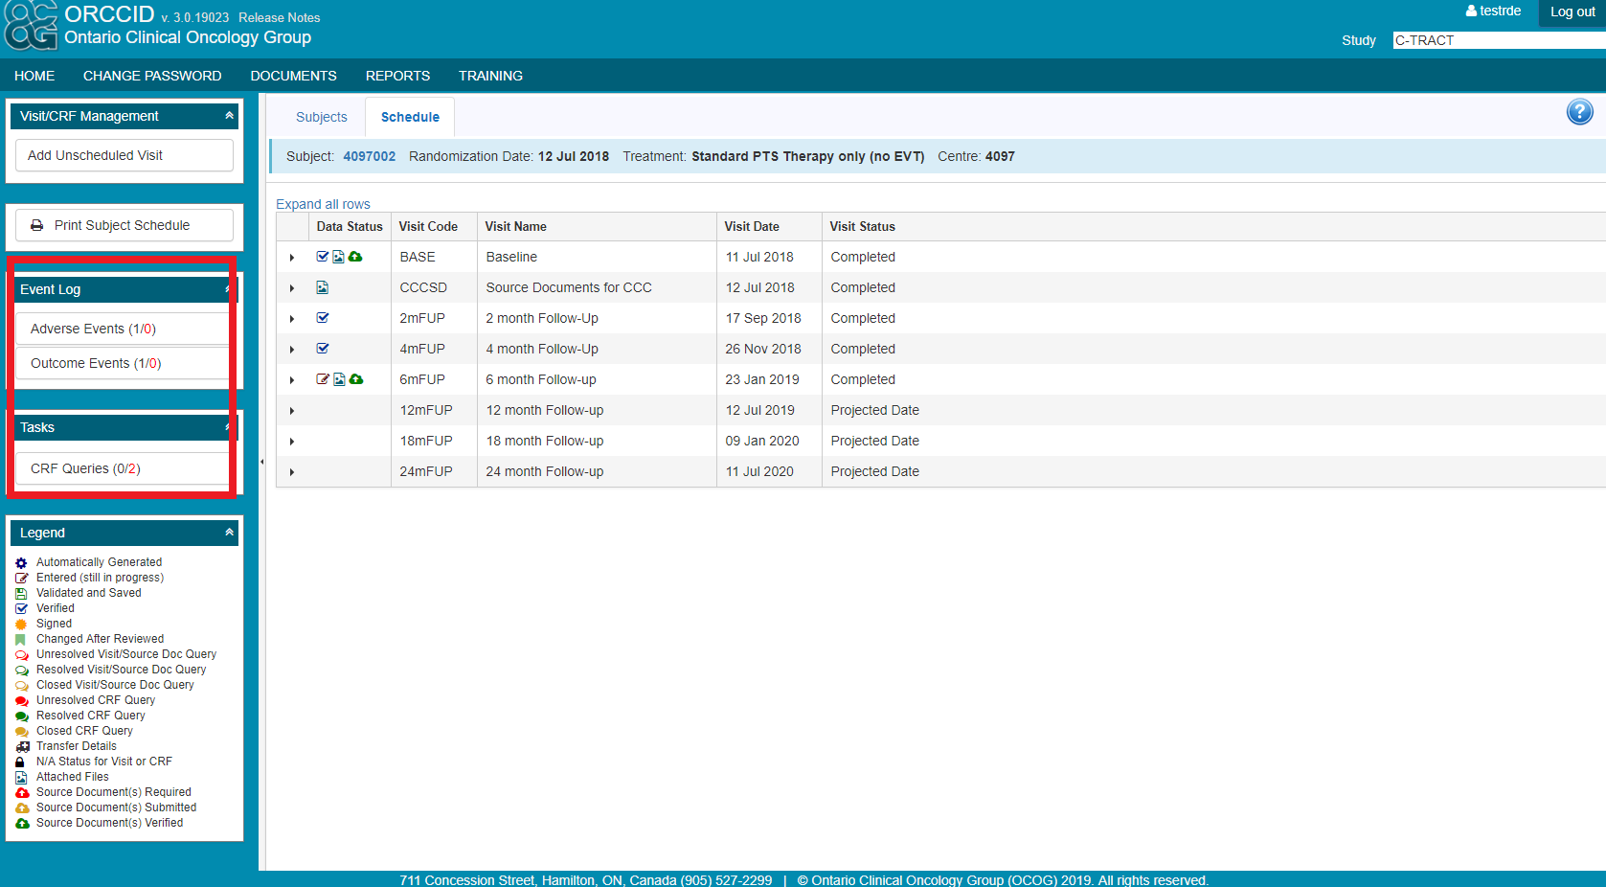
ORCCID

Slide 29
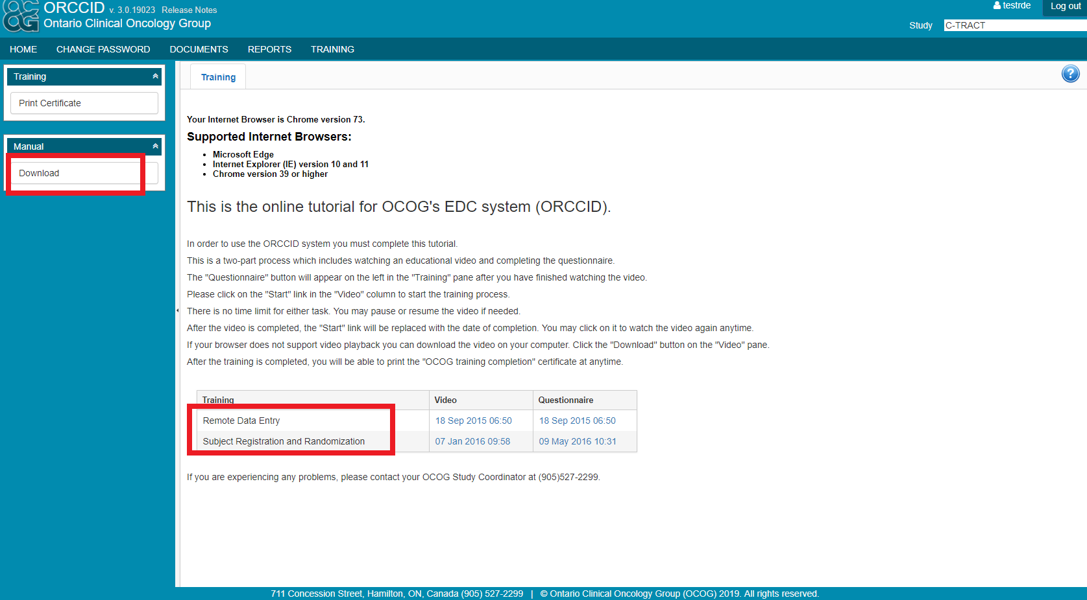
ORCCID

Slide 30
OUTCOME EVENTS

Slide 31
Outcome Events
Suspected Bleeding Event
Suspected Recurrent VTE:
  Suspected DVT, including stent thrombosis
  Suspected PE
Death

Slide 32
Outcome Events
Report ALL clinically suspected bleeding events, even if you think that they are trivial!
Report ALL clinically suspected recurrent DVT and/or PE events!
The Adjudication Committee at the DCC will determine if a bleeding event is Major, Minor or does not meet study criteria for a bleeding event
The Adjudication Committee will also determine if a suspected VTE (DVT and/or PE) event meets study criteria
Notes:
Examples:
ER visit for bloody sputum post-procedure
Rectal bleeding with hospitalization (SAE + suspected bleeding event)
Co-morbid hematuria noted in a discharge note (SAE + suspected bleeding event)

Slide 33
Outcome Events – Stent Thrombosis
Distinguishing new DVT versus deposition of old laminar material in stent can be challenging, old clots and debris can complicate assessment of new clot
Stent thrombosis is usually but not always associated with new onset of symptoms
Therefore:
  1) If stent occlusion is identified as part of routine clinical visit not precipitated by subject symptoms, then DO NOT report as an event
  2) If clinical evaluation is precipitated by patient report of symptoms (e.g. swelling, aching, discomfort in Index leg), then report as an event

Slide 34
Death Event
Notify the CCC within 24 hours of knowledge of this event
Enter an SAE database module in ORCCID
The CCC will report to the CIRB; additional local IRB reporting may be required
Enter a Death and End of Study database module in ORCCID
Notes:
There are changes to this process with the CIRB. The CCC Must submit to the CIRB; in certain instances the CIRB Manager is responsible for notifying the local IRB administrators.
Cause of death will be determined from hospital and outpatient records, autopsy data, and other information. Include an autopsy report, if available
Per protocol section 9.4, death will be attributed to PE if it is unexplained and sudden or there is substantive supporting evidence.

Slide 35
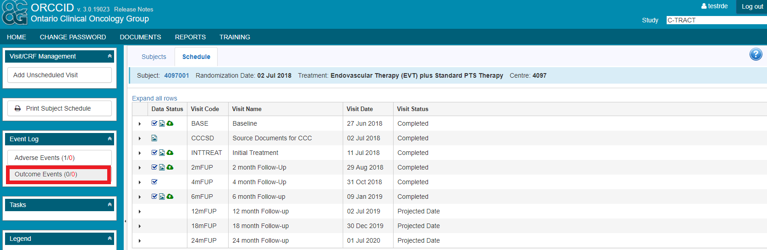
Outcome Events in ORCCID

Slide 36
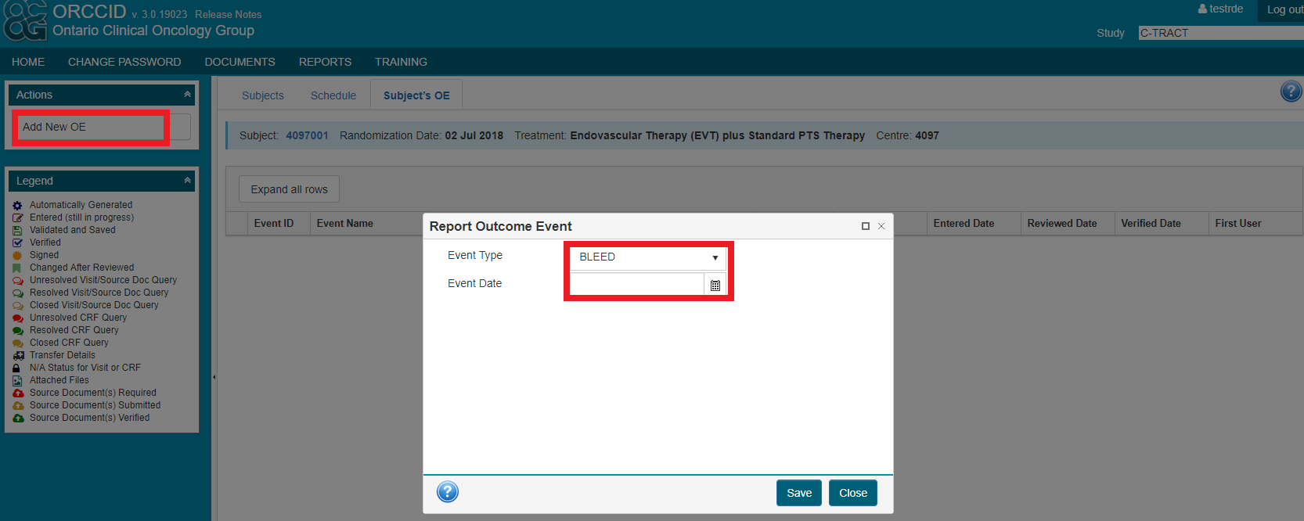
Outcome Events in ORCCID

Slide 37
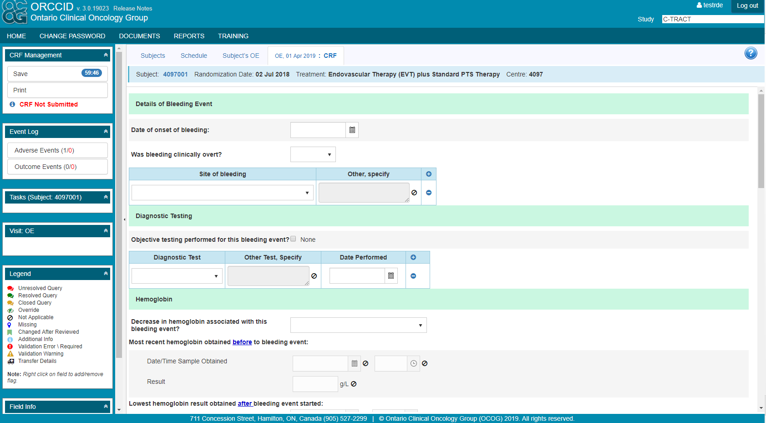
Outcome Events in ORCCID

Slide 38





AE & Adverse Device Effect (ADE) Reporting
Adverse Events should be solicited at all visits
Non-serious AEs must be reported only for the first 30 days after randomization or stent placement, whichever is later; must be reported by the site investigator or personnel into the ORCCID system in the Adverse Event database module within 3 working days after the site investigator or personnel first learn of the event.
Patient report of AE (first knowledge).
Collect information about the event.
Evaluate relatedness, expectedness, and outcome.
Report in ORCCID within 3 working days. Provide updates as available for unresolved events.
Notes:
An AE is any untoward medical occurrence observed in a patient that develops or worsens from baseline status in association with a subject’s participation in the research, whether considered related to research or not

Slide 39
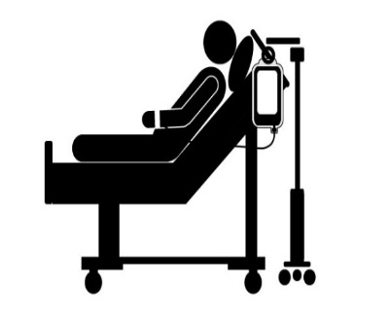

SAE Reporting
Serious Adverse Events that occur within 24 months after randomization must be reported by the site investigator or personnel into the ORCCID system in the Serious Adverse Event database module via the Adverse Events container within 1 working day after the site investigator or personnel first learns of the event.
Collect details about the event including medical records, labs, procedure reports, etc.
Evaluate relatedness, expectedness, and outcome.
Report in ORCCID within 1 working day. Provide updates as available for unresolved events.
Discovery (first knowledge) of SAE.
Reminder: The CCC must report SAEs to regulatory agencies (i.e. CIRB, FDA, DSMB) within 7 business days. The site team plays a critical role in processing of SAEs and compliance with regulatory guidelines.
Notes:
SAE Reporting:
Death
Life-threatening adverse experience
Inpatient hospitalization or prolongation of existing hospitalization
Persistent or significant disability/incapacity
May jeopardize subject’s health and may require medical or surgical intervention to prevent one of the outcomes listed above
At first suspicion of an SAE, contact the CCC to discuss.
Start the process to collect medical records – consider obtaining a patient consent to obtain medical records at the beginning of their participation so that you can request records from outside your immediate facility quickly.

Slide 40
Reminders - What is NOT an AE/SAE?
Pre-existing medical conditions
Previously scheduled hospitalizations and hospitalizations needed for diagnostic or elective surgical procedures for the management of pre-existing medical conditions are not considered AEs
Hospitalizations for diagnostic or elective surgical procedures for management of pre-existing medical conditions
Fluctuations in INR and PTT values or medical treatment (i.e. vitamin K); if not bleeding event
Lower extremity symptoms (e.g. pain, swelling, fatigue, heaviness) clearly due to PTS and ECS; if not investigated for recurrent DVT
Hospitalizations for sole purpose of AC therapy or patient education in AC therapy
Notes:
*A pre-existing medical condition should be reassessed during the trial and reported as an AE or SAE only if the frequency, severity, or character of the condition worsens significantly or unexpectedly during the study.

Slide 41
UADE and UP Reporting
UADE and UPs that occur within 24 months after randomization must be reported by the site investigator or personnel into the ORCCID system in the Serious Adverse Event database module via the Adverse Events container within 1 working day after the site investigator or personnel first learn of the event.
Collect details about the event including medical records, labs, procedure reports, etc.
Evaluate relatedness, expectedness, and outcome.
Report in ORCCID within 1 working day. Provide updates as available for unresolved events.
Discovery (first knowledge) of UADE or UP.
Reminder: The CCC must report UADEs to regulatory agencies (i.e. CIRB, FDA, DSMB) within 10 business days and Unanticipated Events that are SAEs within 7 business days. The site team plays a critical role in processing of UADEs/SAE-UPs and compliance with regulatory guidelines.
Notes:
Any serious adverse effect on health or safety, or any life-threatening problem or death caused by, or associated with, a device
It is for this reason for compliance with device reporting guidelines. UDI # is required for reporting and must be source verified by the CCC to ensure the sponsor master accountability log is correct.

Slide 42
Unanticipated Problem (UP)
Collected Per OHRP Regulations
Definition:
Any incident, experience, or outcome that meets all of the following criteria:
  It is unexpected (in terms of nature, severity, or frequency) given the research procedures that are described in the protocol-related documents;
  It is related or possibly related to participation in the research; and
  It suggests that the research places participants or others at a greater risk of harm than was previously known or recognized.
  Note: Per OHRP guidelines, any AE that is serious (i.e. a SAE), unexpected, and related or possibly related to participation in the research automatically meets this third criterion.
Captured via AE and SAE database module in ORCCID
Notify CCC immediately of any UPs
Notes:
Again, some confusion about unexpected and relatedness alone classifying event as UP.

Slide 43
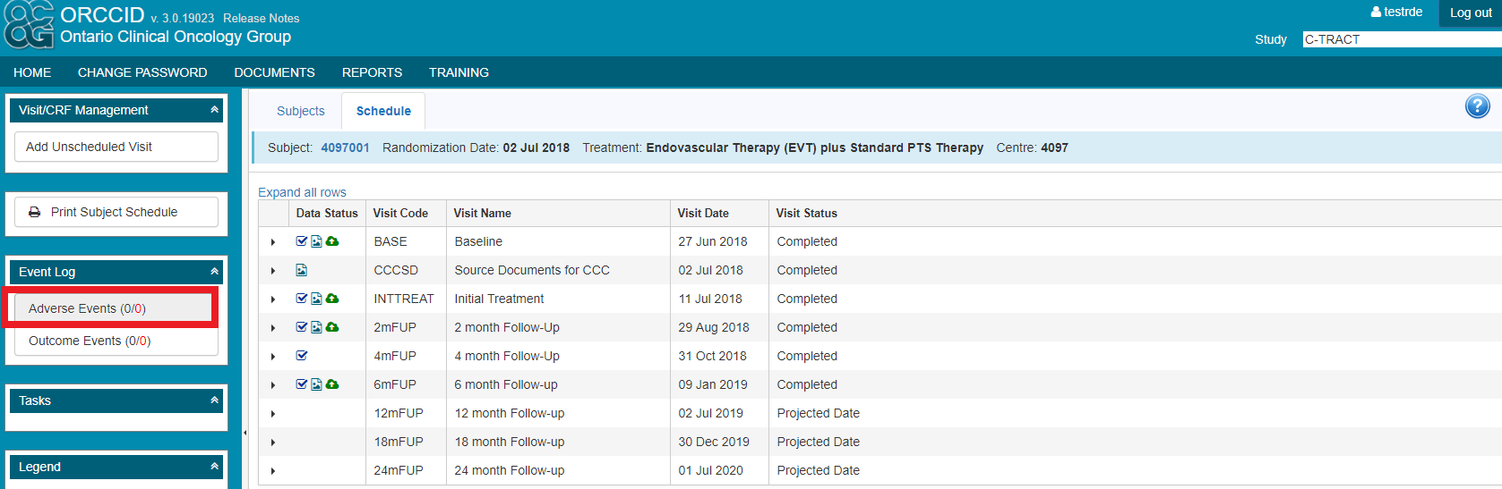
AEs/SAEs in ORCCID

Slide 44
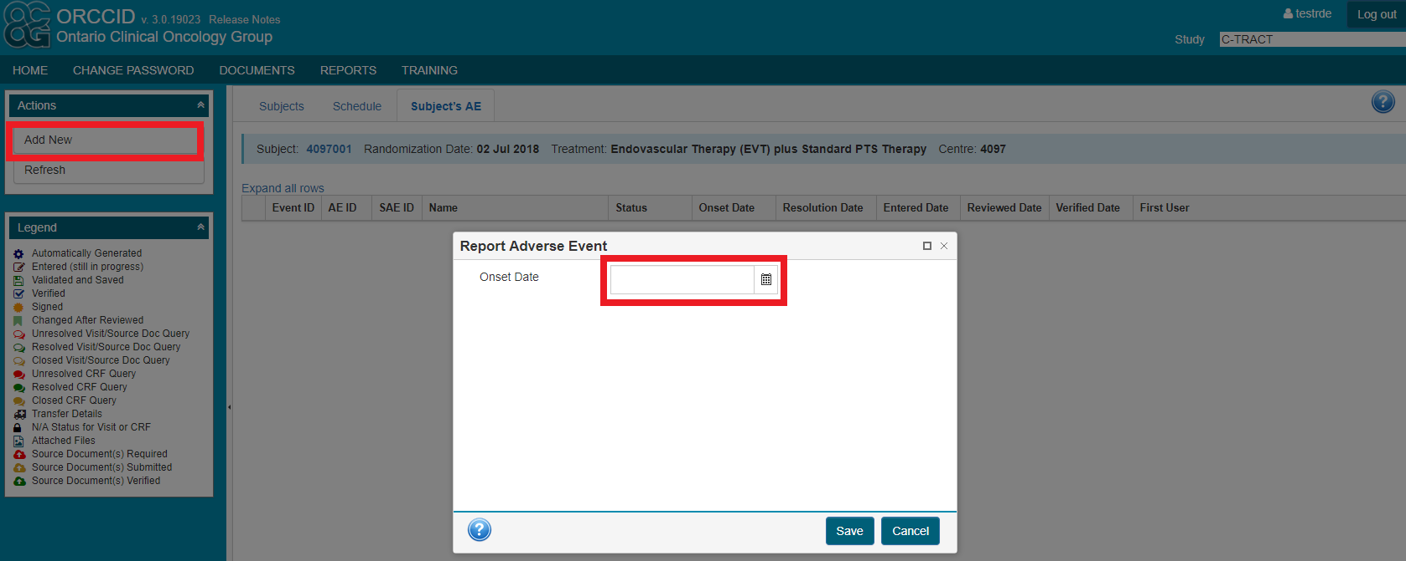
AEs/SAEs in ORCCID

Slide 45
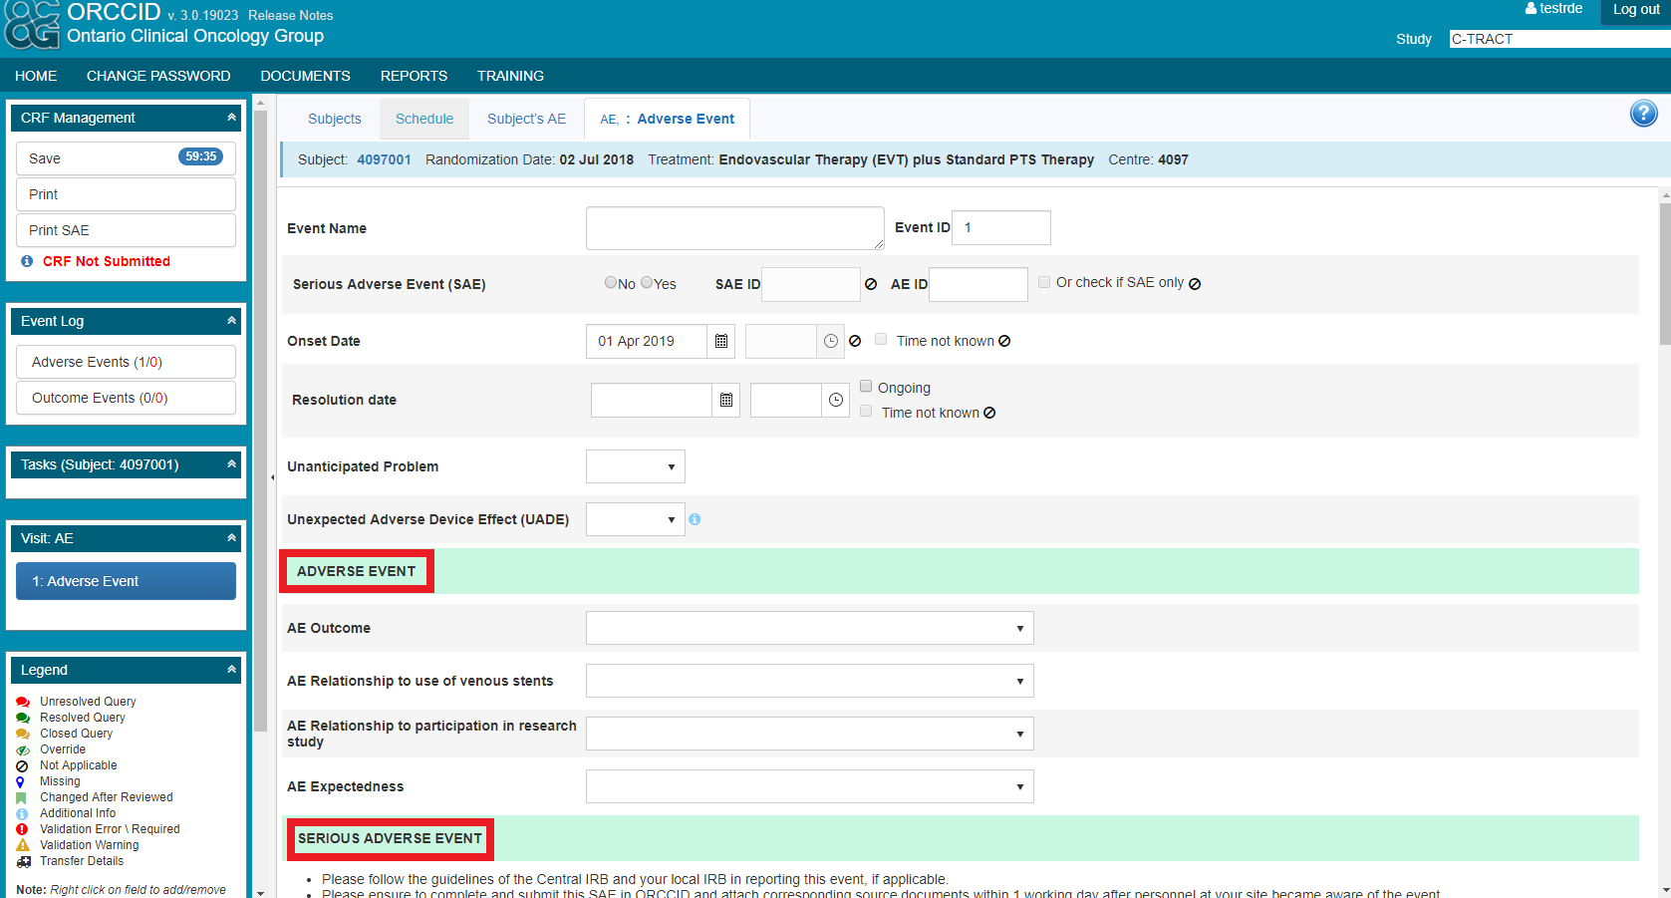
AEs/SAEs in ORCCID

Slide 46
Unscheduled Visits
Report Unscheduled Visits for events such as:
  Late Endovascular Procedure (re-stenting)
  Endovenous Ablation Procedure (post Initial Stent Procedure)
  Subsequent Hospitalization (for SAE)
  Early End of Study (e.g. subject withdrawal)

Slide 47
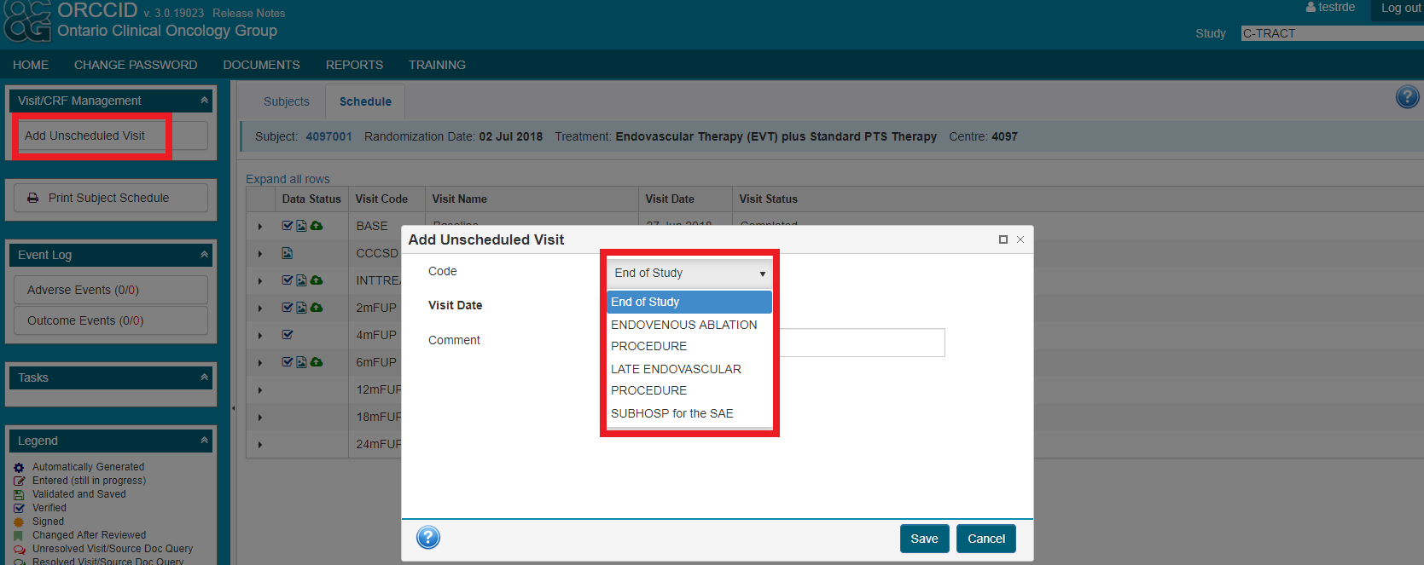
Unscheduled Visits in ORCCID
Reported in ORCCID by adding an Unscheduled Visit to the schedule of assessments:

Slide 48


