Slide 1

I don’t need no #**## stents!
Suman Wasan, MD, MS
Adjunct Professor, Department of Surgery
UNC Health Rex Vascular Specialists
Raleigh, NC

Slide 2
Disclosure
Janssen: Educational speaker
BMS Pfizer: Advisory board

Slide 3
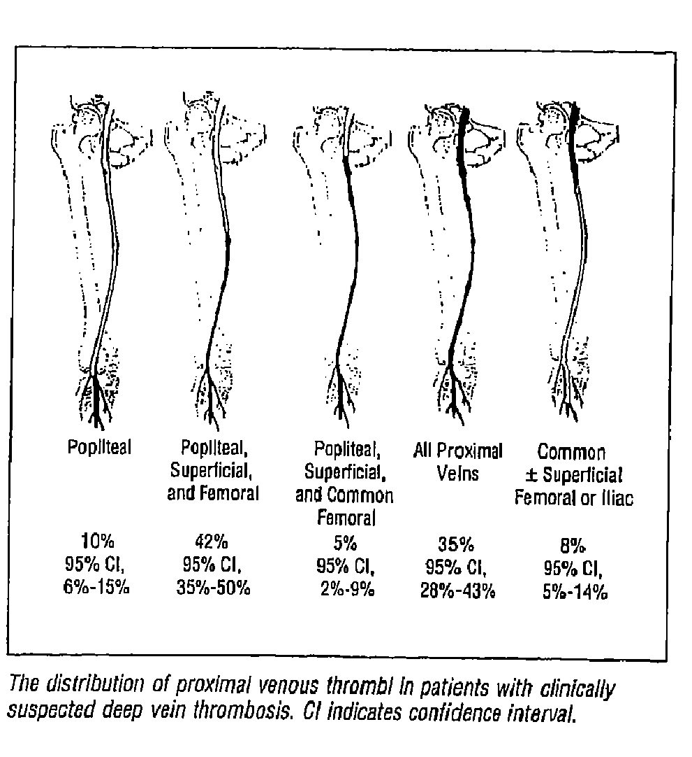

Iliofemoral DVT
    Iliofemoral DVT has more serious long-term consequences than infra-inguinal DVT
    After 5 years:
    - 95% develop chronic venous insufficiency
    - nearly ½ have venous claudication
    - 15% develop venous ulcers
    - substantially reduced Quality of Life
    CVD accounts for 1-3% of total healthcare budget
    Venous Ulcers Result in: ~2 million lost work days/year in the U.S. and treatment costs of $3 billion/year
Cogo, Arch Int Med
1993;153:2777

Slide 4
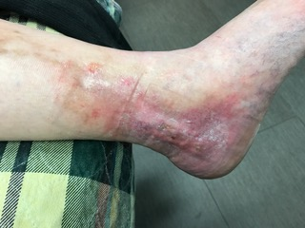
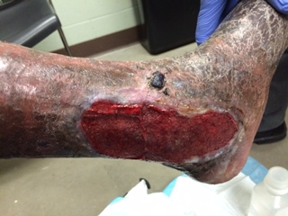
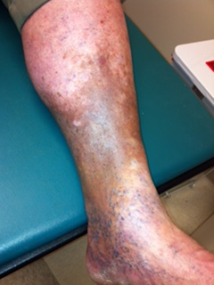
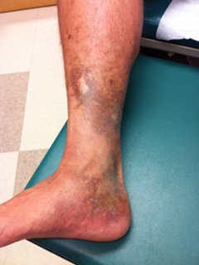
5% look like this

Slide 5
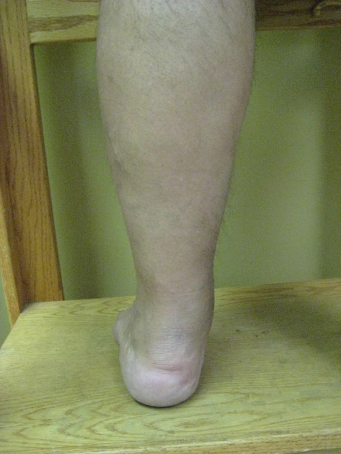
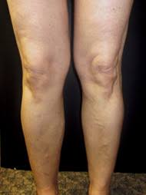
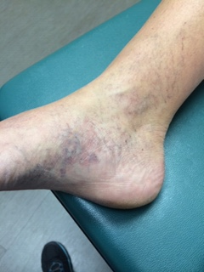
95% look like this!

Slide 6
Physiological mechanisms of PTS
Increased recurrent DVT
Higher venous and compartmental pressure
Venous valve dysfunction
Saphenous vein reflux
Ambulatory venous hypertension: edema, calf pump dysfunction, tissue hypoxia, subcutaneous fibrosis and ulceration.

Slide 7
VFI is a good predictor of venous reflux
VFI is the best determinant of clinical severity
of venous disease

Slide 8
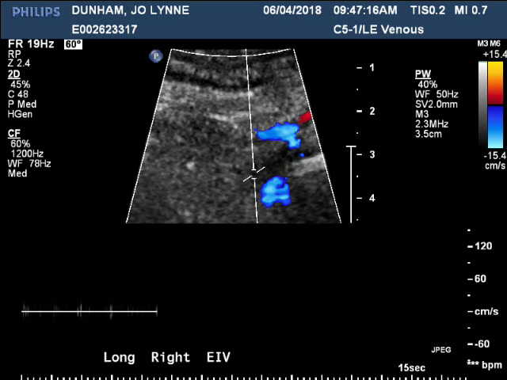
Villalta 10
VCSS 9
Villalta severity
5-9: mild PTS
10-14: moderate PTS
15 or above: severe PTS
VFI 1.393 right
1.797 left

Slide 10
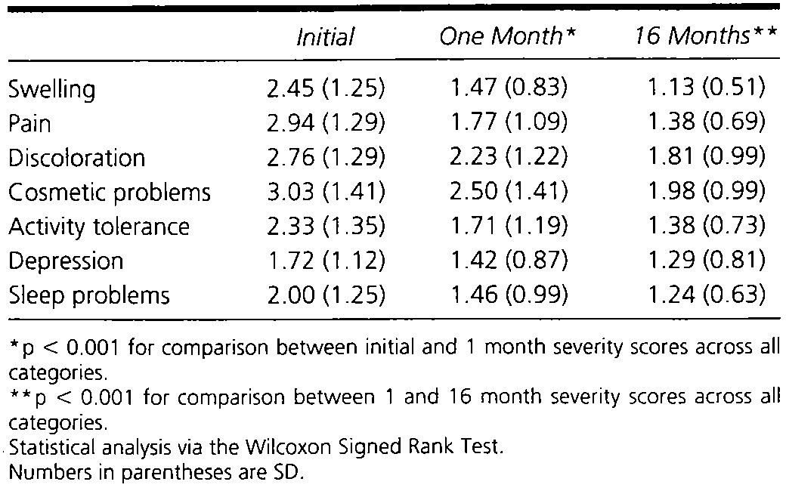
Evaluation of Therapeutic Compression Stockings in the Treatment of CVI
Motykie Derm Surg 1999;25:116-20
Notes:
Motykie study 1999, 112 pts with CVI, measured QOL
Applied 30-40mmg Hg knee to thigh length compression
Improvement in patient severity scores at 1 and 16 moths vs. baseline
Acceptable patient tolerance and compliance (70% still wearing them at 16 months)

Slide 12
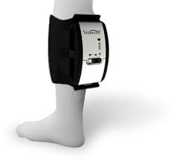

Slide 14
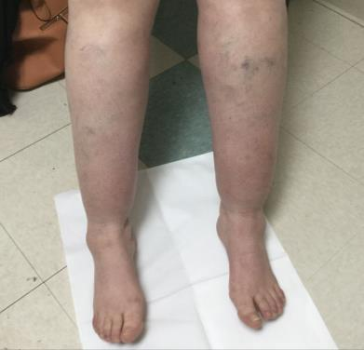
C3 – Where there is swelling, there are overtaxed lymphatics
CEAP Stage
  C3 – Edema (pitting)
  C3 – Edema (non-pitting)
Lymphatic stage & involvement
  Lymphedema Stage 1: Soft swelling; possibly intermittent, likely daily; resolves with elevation or overnight
  Lymphatics are unable to accommodate the excess venous filtrate and swelling occurs
  Lymphedema Stage 2: Spongy swelling due to fibrosis; does not resolve with elevation; possible hyperkeratosis and scaly skin
  Extended excess venous filtrate overtaxes lymphatics, resulting in protein buildup and permanent damage and/or obstruction of lymphatics
=
=

Slide 17
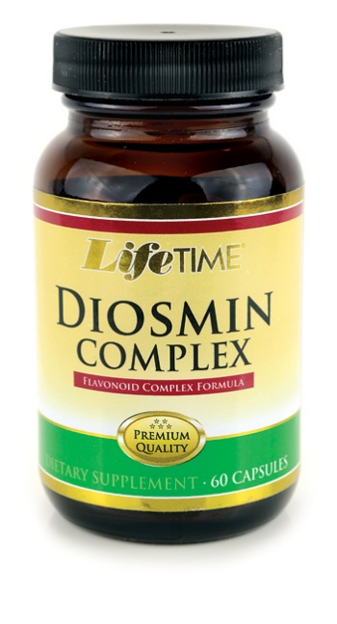
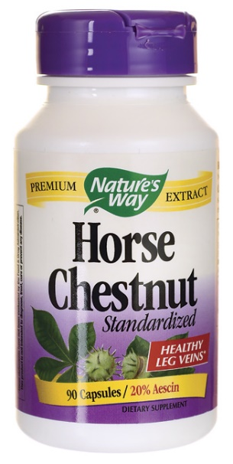
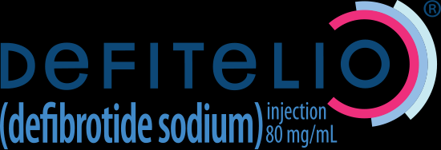

Slide 18

Six-month exercise training program to treat post-thrombotic syndrome: a randomized controlled two-centre trial
Susan R. Kahn, MD MSc, Ian Shrier, MD PhD, Stan Shapiro, PhD, Adrielle H. Houweling, MSc, Andrew M. Hirsch, MD, Robert D. Reid, PhD MBA, Clive Kearon, MB PhD, Khalil Rabhi, PhD, Marc A. Rodger, MD MSc, Michael J. Kovacs, MD, David R. Anderson, MD, and Philip S. Wells, MD MSc
Results
Of 95 patients with post-thrombotic syndrome, 69 were eligible, 43 consented and were randomized, and 39 completed the study. Exercise training was associated with improvement in VEINES-QOL scores (exercise training mean change 6.0, standard deviation [SD] 5.1 v. control mean change 1.4, SD 7.2; difference 4.6, 95% CI 0.54 to 8.7; p = 0.027) and improvement in scores on the Villalta scale (exercise training mean change −3.6, SD 3.7 v. control mean change −1.6, SD 4.3; difference −2.0, 95% CI −4.6 to 0.6; p = 0.14). Most secondary outcomes also showed greater improvement in the exercise training group.
CMAJ. 2011 Jan 11; 183(1): 37–44.

Slide 19
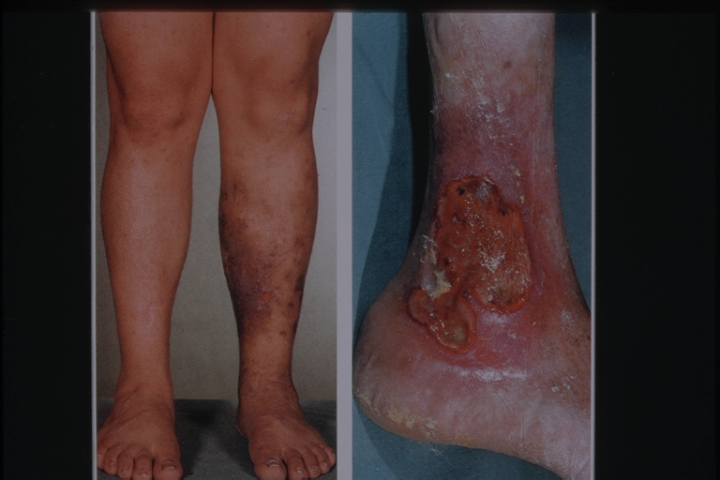
Low molecular weight heparin improves healing of chronic venous ulcers especially in the elderly
ABSTRACT
Venous ulcers are common, especially in the elderly, accounting for more than 50% of all lower extremity ulcers with important socioeconomic problems. Improving extracellular matrix functioning, by heparin administration, seems to be a way to support wound healing. A total of 284 patients with venous ulcers were recruited in a 4-year period. All patients were subjected to the most appropriate treatment after considering their preference (compression therapy followed or not by vein surgery). Patients were randomised into two groups of 142 persons in each (group A and group B as cases and controls, respectively). Patients of group A, in addition to the basic treatment as described earlier, received administration of nadroparin 2850 IU/0.3 ml through subcutaneous injection once a day for 12 months, whereas group B patients received basic treatment alone. Healing was assessed by means of direct ulcer tracing with computerised planimetry. Group A showed a healing rate of 83·80% at 12 months, whereas that of group B was 60·56%. Results by age group surprisingly showed that the group of older patients took the most advantage from long-term treatment with low molecular weight heparin; this group also had lowest recurrence rate.
Int Wound J 2015;12:150-3.

Slide 20
Table 2. Healing rates at 12 months
 | Group A | Group B
Healed ulcers | 119 (83·80%) | 86 (60·56%)
Mean area healing per week (cm²/week) | 1·3 | 0·87
Non-healing ulcers | 23 (16·19%) | 58 (40·84%)
P value | <0·00001
Table 3. Healing rates at 12 months according to age range
 | Group A | Group B
Healed ulcers
48–64 years | 30/42 (71·42%) | 37/39 (94·87%)
65–79 years | 54/62 (87·09%) | 39/67 (58·20%)
80+ years | 35/38 (91·10%) | 10/36 (27·77%)
Int Wound J 2015;12:150-3.

Slide 21
Postthrombotic Syndrome in PatientsTreated With Rivaroxaban or Warfarinfor Venous Thromboembolism
Abstract
Postthrombotic syndrome (PTS) is a frequent complication of venous thromboembolism (VTE). Using MarketScan claims data from January 2012 to June 2015, we identified adults with a primary diagnosis code for VTE during a hospitalization/emergency department visit, 6 months of insurance coverage prior to the index event and newly started on rivaroxaban or warfarin within 30 days of the index VTE. Patients with <4-month follow-up postindex event or a claim for any anticoagulant during 6-month
baseline period were excluded. Differences in baseline characteristics between rivaroxaban and warfarin users were adjusted for using inverse probability of treatment weights based on propensity scores. Patients were followed for the development of PTS starting 3 months after the index VTE. Cox regression was performed and reported as hazard ratios with 95% confidence
intervals (CIs). In total, 10 463 rivaroxaban and 26 494 warfarin users were followed for a mean of 16+9 (range, 4-39) months. Duration of anticoagulation was similar between cohorts (median ¼ 6 months). Rivaroxaban was associated with a 23% (95% CI:16-30) reduced hazard of PTS versus warfarin. Rivaroxaban was associated with a significant risk reduction in symptoms of PTS compared to warfarin in patients with VTE treated in routine practice.
Clinical and Applied
Thrombosis/Hemostasis
2018, Vol. 24(4) 575-582

Slide 22

Original Article
A Randomized Trial of Early Endovenous Ablation in Venous Ulceration
Manjit S. Gohel, M.D., Francine Heatley, B.Sc., Xinxue Liu, Ph.D., Andrew Bradbury, M.D., Richard Bulbulia, M.D., Nicky Cullum, Ph.D., David M. Epstein, Ph.D., Isaac Nyamekye, M.D., Keith R. Poskitt, M.D., Sophie Renton, M.S., Jane Warwick, Ph.D., Alun H. Davies, D.Sc., for the EVRA Trial Investigators
N Engl J Med
Volume 378(22):2105-2114
May 31, 2018

Slide 23
ATTRACT – Secondary Analyses
Comerota et al, Circulation 2019; Kearon et al, JTH 2019; Weinberg et al, Vasc Med 2019; Magnuson, Circ CVQO 2019
Femoral-popliteal DVT: no benefit whatsoever
IFDVT: reduces mod-severe PTS (18% vs 28%, p=0.02)
Substudy: does not reduce valvular reflux at 1 year
Costly: $220,041/QALY (for IFDVT; $137,526/QALY)
IFDVT: reduces early leg pain and swelling (p<0.01)

Slide 24
DUTCH-CAVA: Ultrasound-Assisted CDT
Notten P et al, Lancet Haematol 2020
Study | [CDT] | Control | P
ATTRACT-IFDVT (2-yr PTS) | 49% | 51% | 0.59
DUTCH-CAVA (1-yr PTS) | 42% | 44% | 0.45
ATTRACT-IFDVT (2-yr MS-PTS) | 18% | 28% | 0.021
DUTCH-CAVA (1-yr MS-PTS) | 16% | 25% | ND
Findings nearly identical to ATTRACT Trial
Exception: US-CDT => no QOL benefit (1-yr)

Slide 25
Questions about angioplasty/stent remain:
Stent longevity and patency: 1 year 60-80%
Immediate post procedure and short term AC therapy
Long term AC/antiplatelet therapy
Pregnancy
Unknown durability of clinical benefit

Slide 26
Medical therapy improves:
Pain
Swelling
Inflammation and tissue changes
Venous ulcer healing
QOL
With NO RISK!

