Slide 1
Stents help patients with iliac obstructive PTS! Haven’t we already figured this out?
Kush R Desai, MD FSIR
Associate Professor of Radiology, Surgery, and Medicine
Northwestern University
Feinberg School of Medicine
Chicago, Illinois

Slide 2
What my esteemed opponent may say…
The available data are limited
Bias!
Uncontrolled, unblinded, small sample size…
Lack of consensus
The procedure is not without risks
Vascular injury (arterial and venous)
Stent migration, occlusion, stenosis, or other malfunction
Acute DVT
Nerve injury/parasthesias
Most patients do not avail themselves of best supportive therapy (and their providers often are not proactive)
Poor stocking compliance
Sproadic/absent wound care
Limited compliance with venoactives

Slide 3
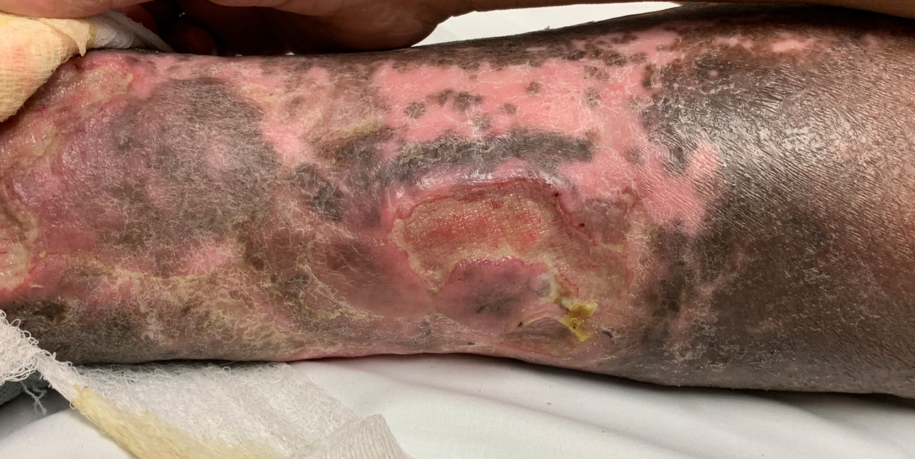
Notes:
But even with best supportive therapy, are we ok with this?

Slide 4
Stents work!
How can restoration of flow/resolving obstruction be a BAD thing?
Sure, no RCT data but what’s there is compelling

Slide 5
982 limbs, 464 post-thrombotic limbs
Pain reduction
Reduction in severe swelling (36→18%)
Ulcer healing (68%)
Neglen et al. JVS VL, 2007
Notes:
And the data agrees!

Slide 6
But stents work!
Procedure carry inherent risk, but it IS an occluded vein…
Can we really make it much worse?
Patient testimonials:
“That wound closed, and stayed closed, for the first time in years”
“I can now walk my dog pain free”
”I’ve lost 30 lbs because I can actually exercise”

Slide 7
Previously…
Off-label usage of stents
Self expanding elgiloy or nitinol stents
Design was not disease-specific
Difficult/required experience to place accurately
Foreshortening
Limited radial force/crush resistance
Limited stent lengths (multiple stents needed)
Trade-off for appropriate diameter
Elgiloy stents → Unknown what final diameter it will be (based on deployed length)
Nitinol stents → Only went up to 14 mm

Slide 8
And we now have disease-specific tools!
On-label stents prospectively evaluated in IDE studies
Results; 2 year VIRTUS and VERNACULAR data
Primary patency in PTS: 73.4% and 75.4% (respectively)
More stents on the way
Better crush resistance, reliability in deployment, predictable diameters, and longer stent lengths!

Slide 9
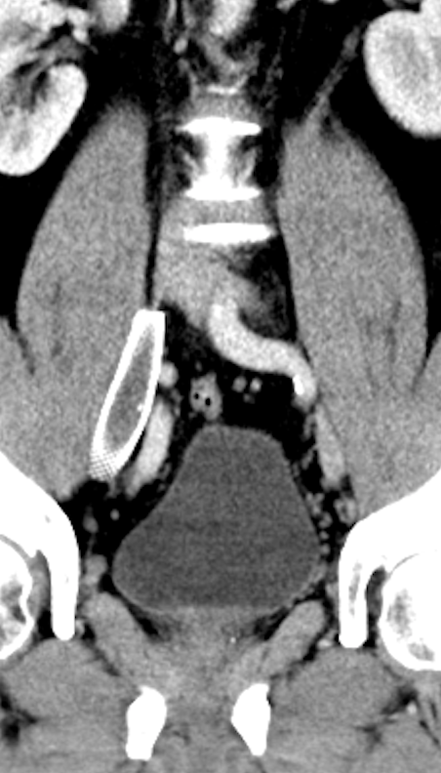

Slide 10
Better deployment accuracy!

Slide 11
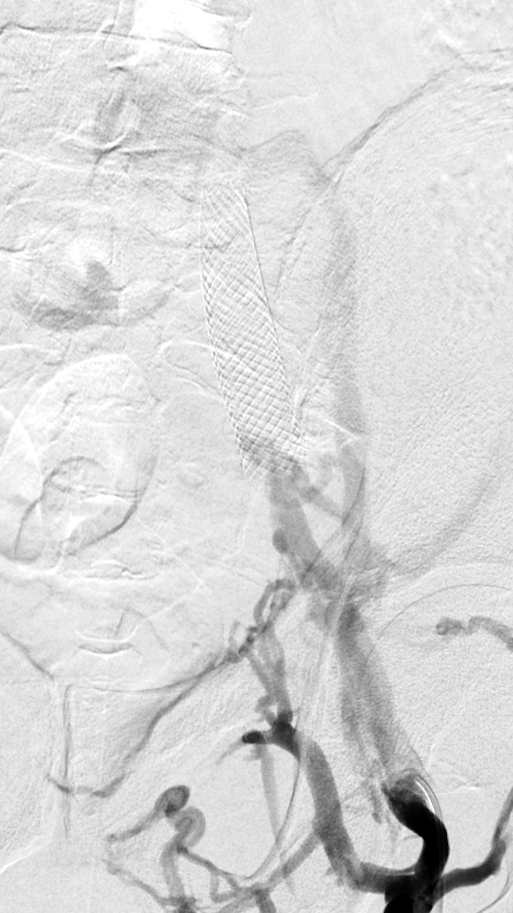
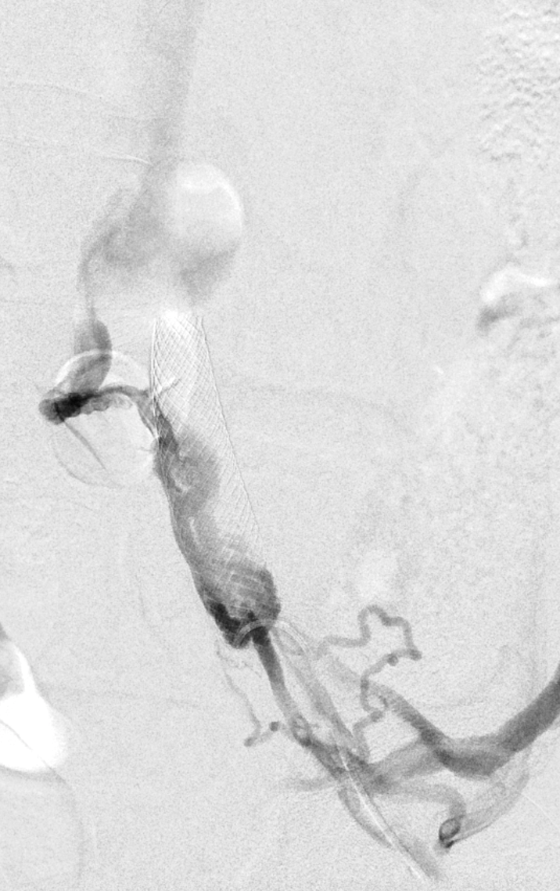

Slide 12
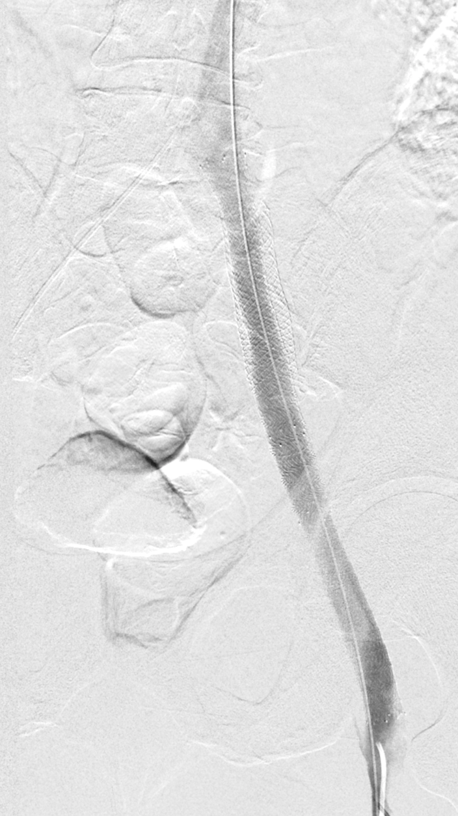

Slide 13
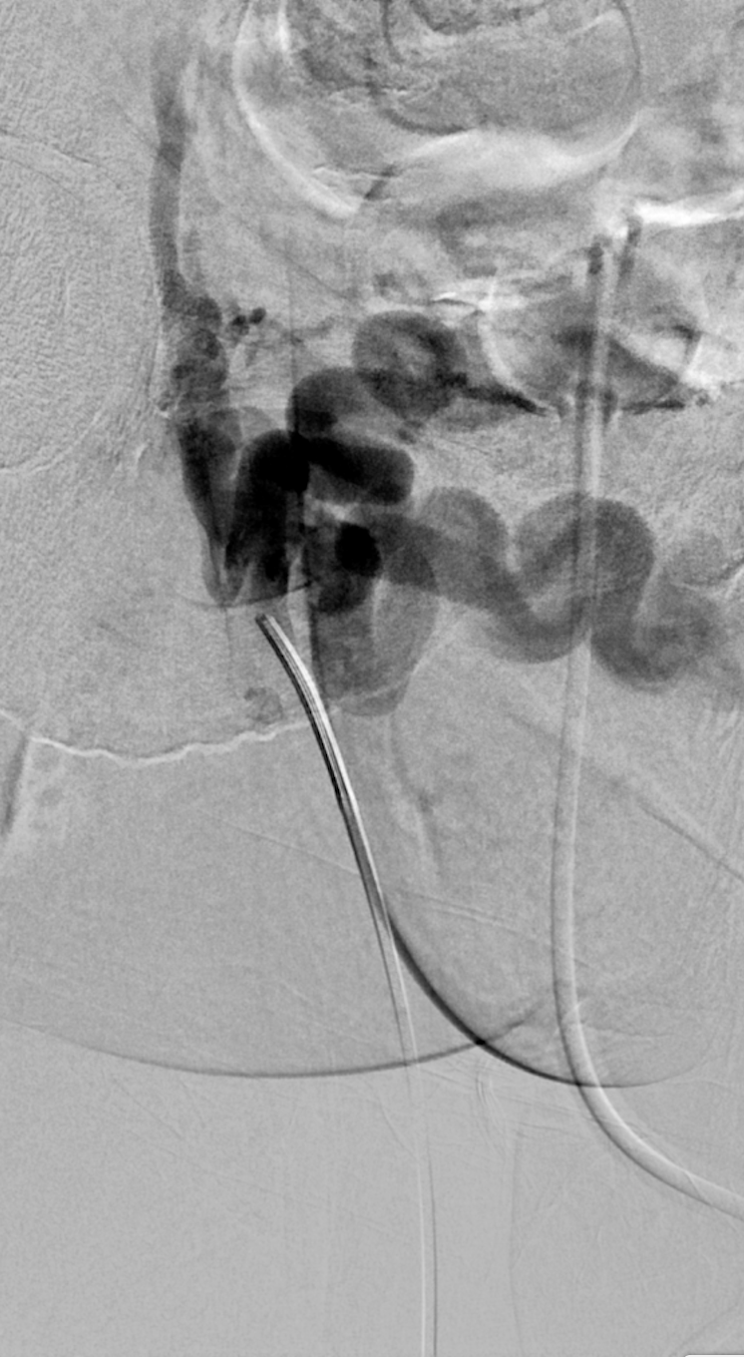
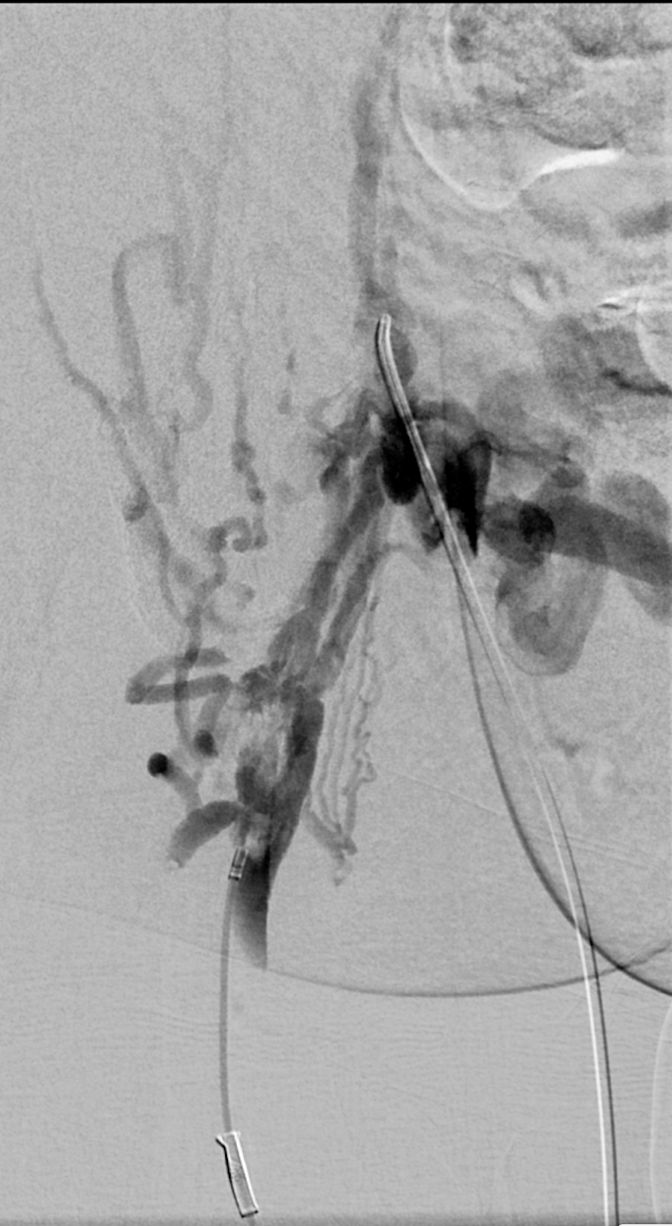

Slide 14
Longer lengths…less stents needed!

Slide 15
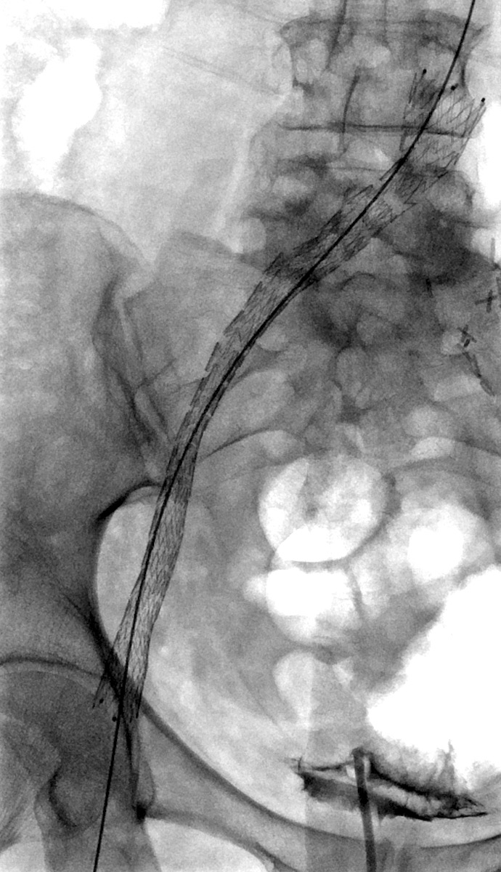
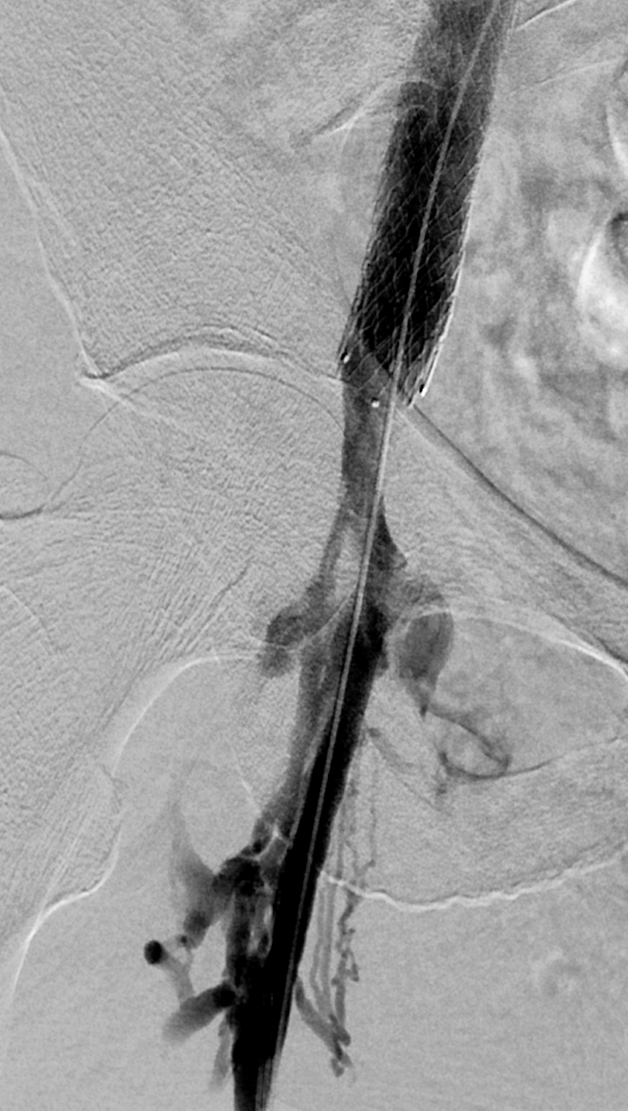
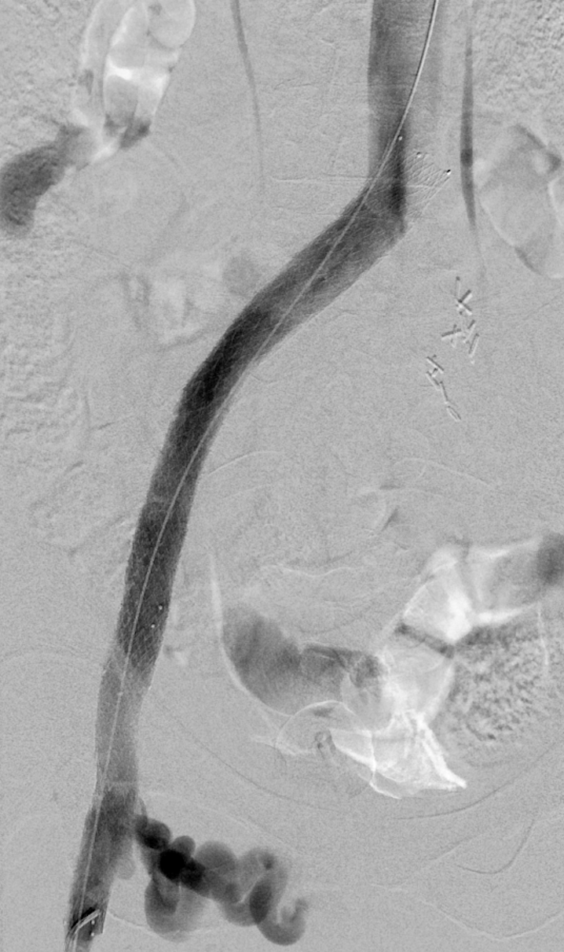

Slide 16
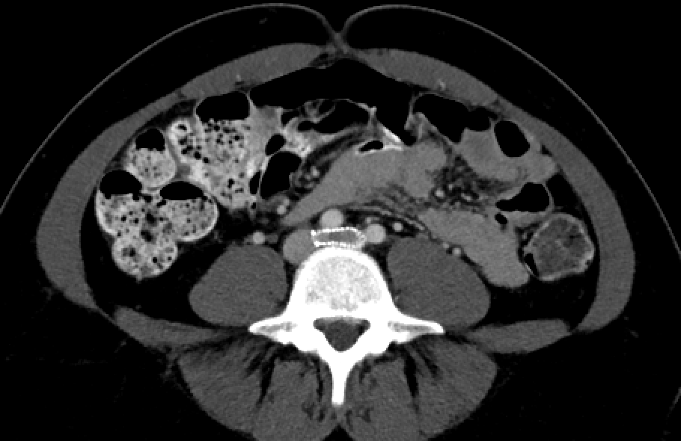
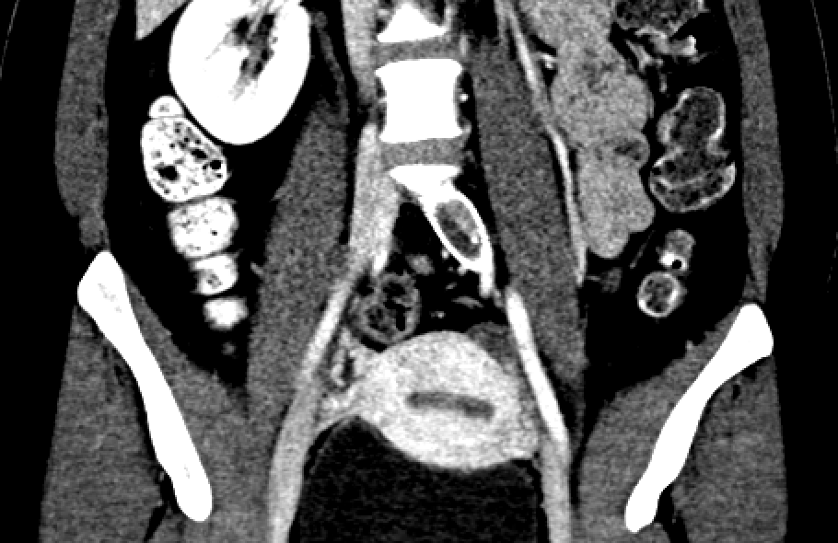

Slide 17
Improved crush resistance!

Slide 18
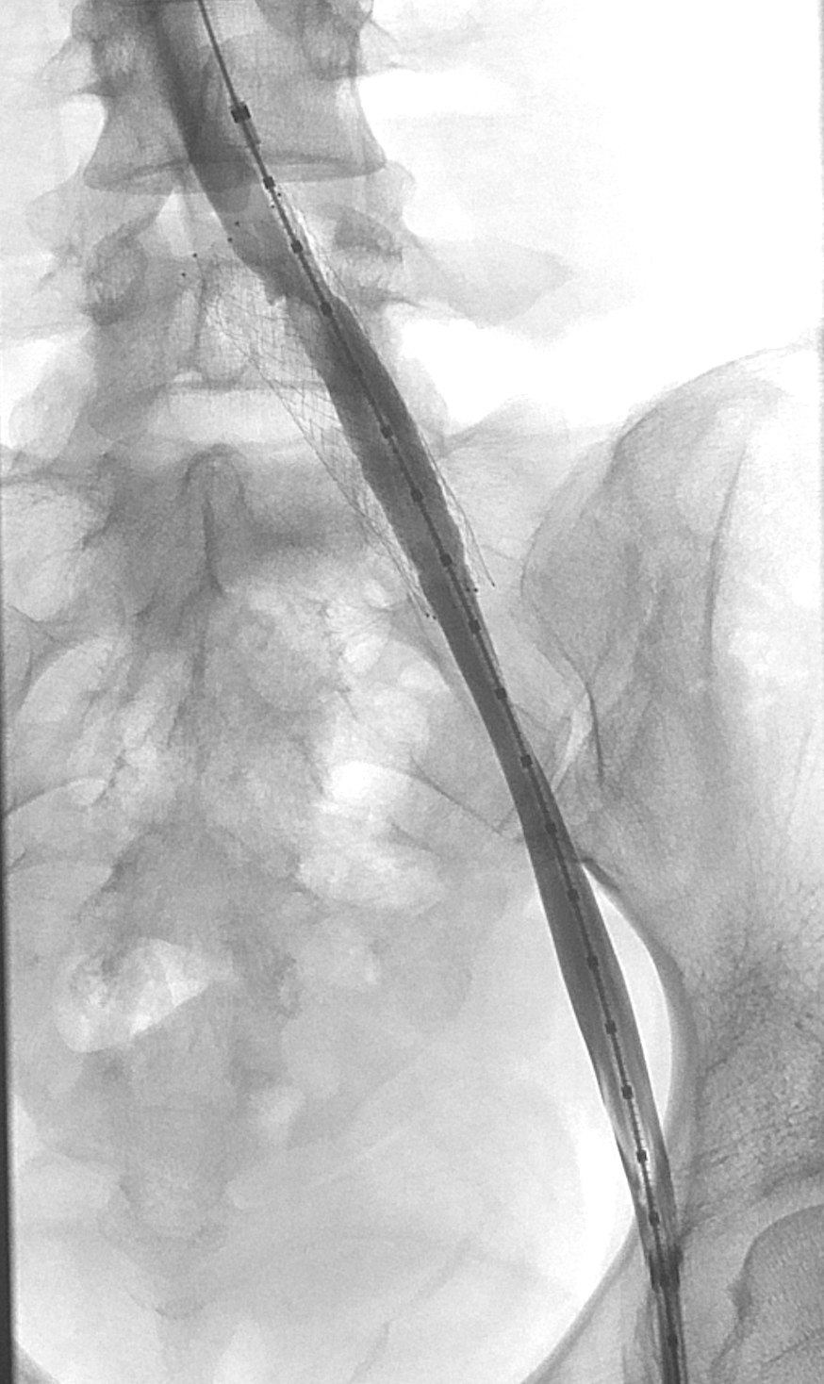
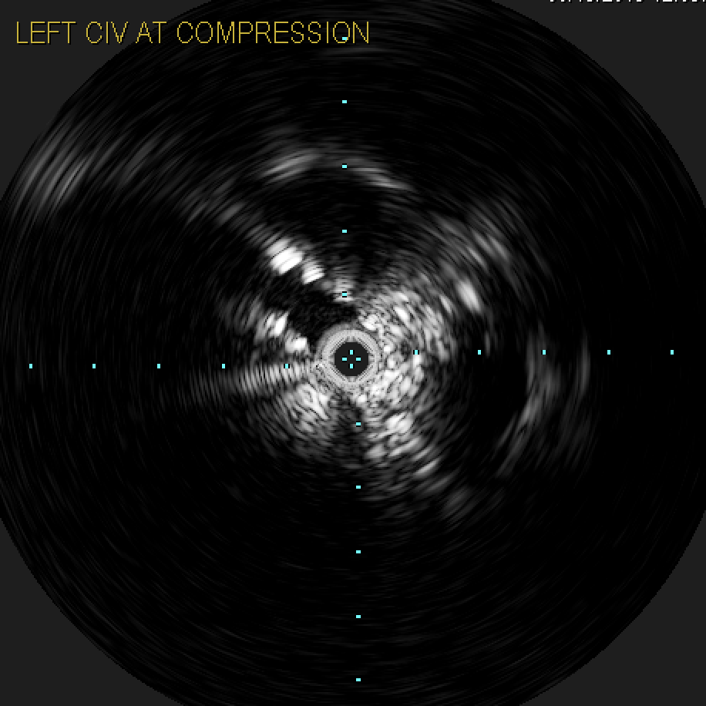

Slide 19
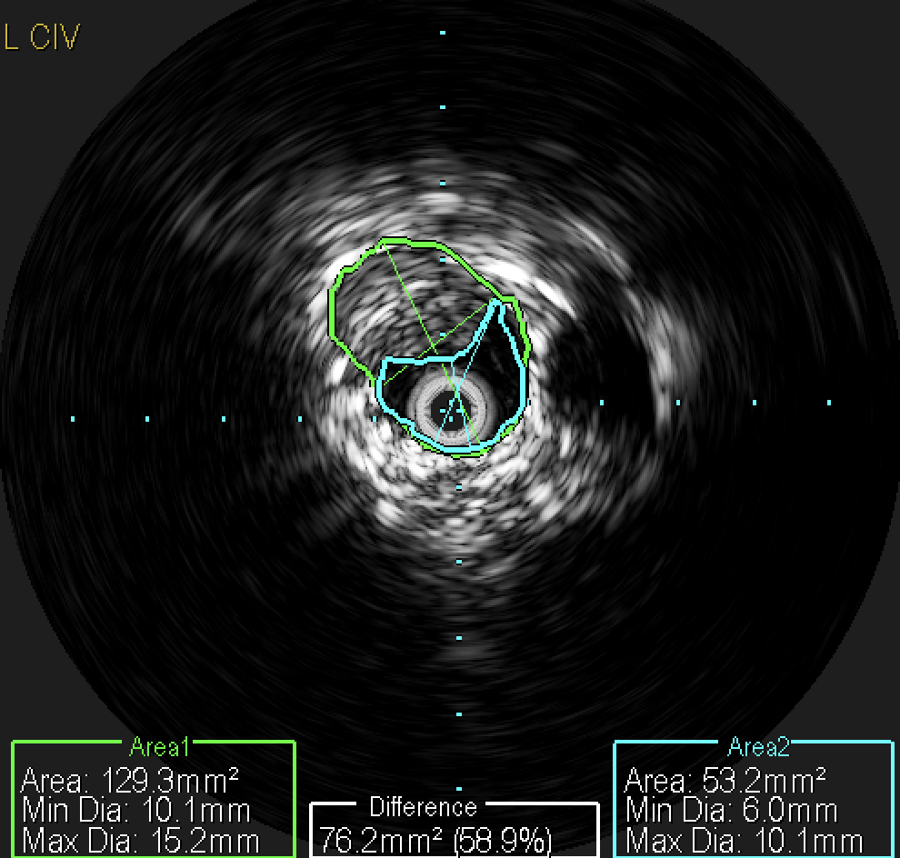

Slide 20
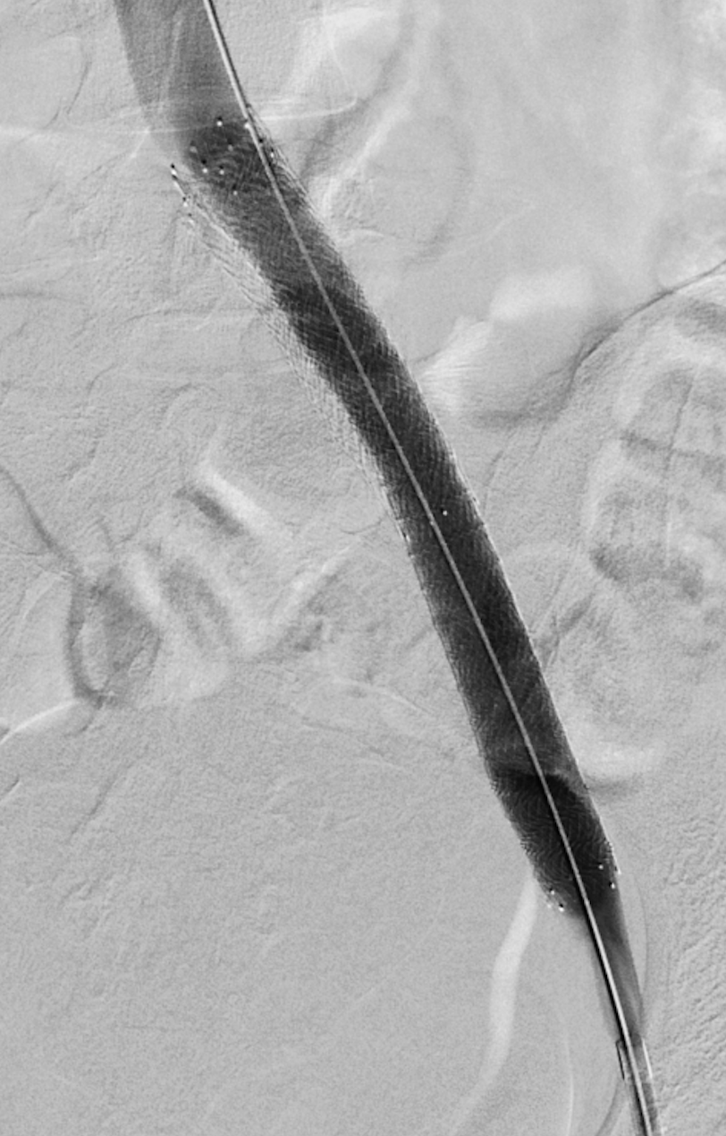
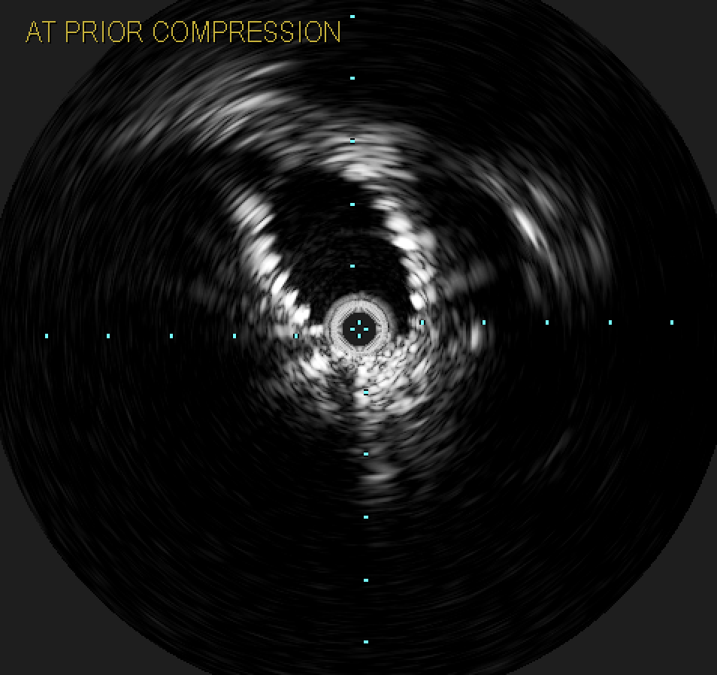

Slide 21
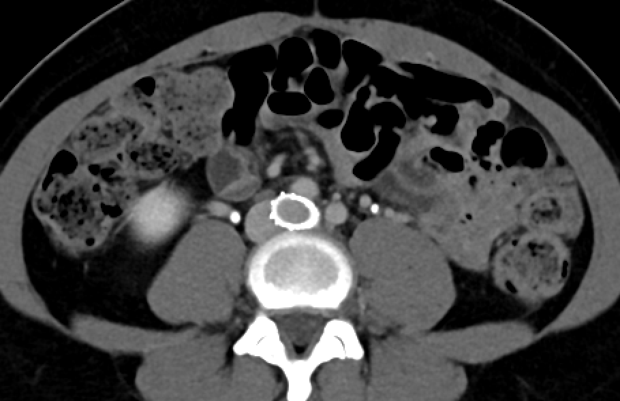
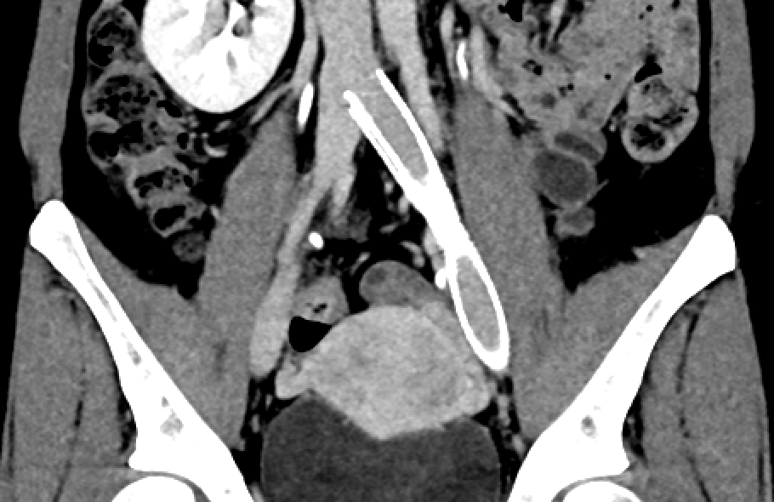

Slide 22
Conclusion
Existing data is pretty good
More to come with disease-specific devices!
Like anything, the procedure is relatively safe in experienced hands
Needs to be studied further, but IDE trial data is encouraging
We all agree that we need to improve non-procedural care of these patients
But do we need to stop providing them relief to improve this practice?

